Slide 1
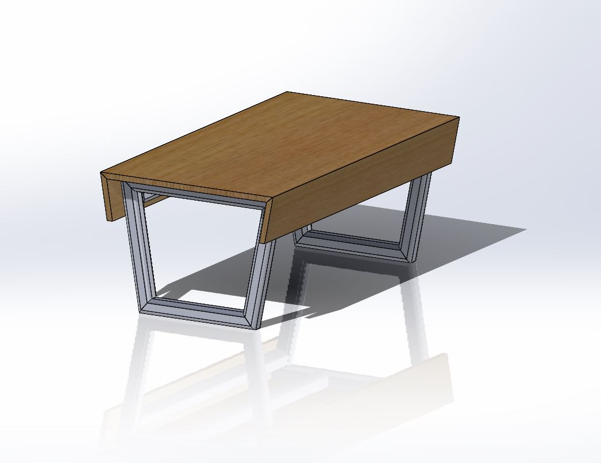
Part Processing
Mesh Classification
Tim Fuger
May, 2023

Slide 2
Business Problem
Reduce engineering time and error in order to assign the manufacturing process for individual parts at Fab Inc.
Notes:
Explain a convolutional neural network, type of model that a data scientist can use that works well in image classification

Slide 3


Business Problem
Reduce time
Reduce human error
8 hours per month
7%
Notes:
Objective to result in the following
Not required to input material manually into a screen
Machines are predictable and can be trained to get it right.
<a href="https://www.flaticon.com/free-icons/human-error" title="human error icons">Human error icons created by Parzival’ 1997 - Flaticon</a>
<a href="https://www.flaticon.com/free-icons/down-time" title="down time icons">Down time icons created by Freepik - Flaticon</a>

Slide 4
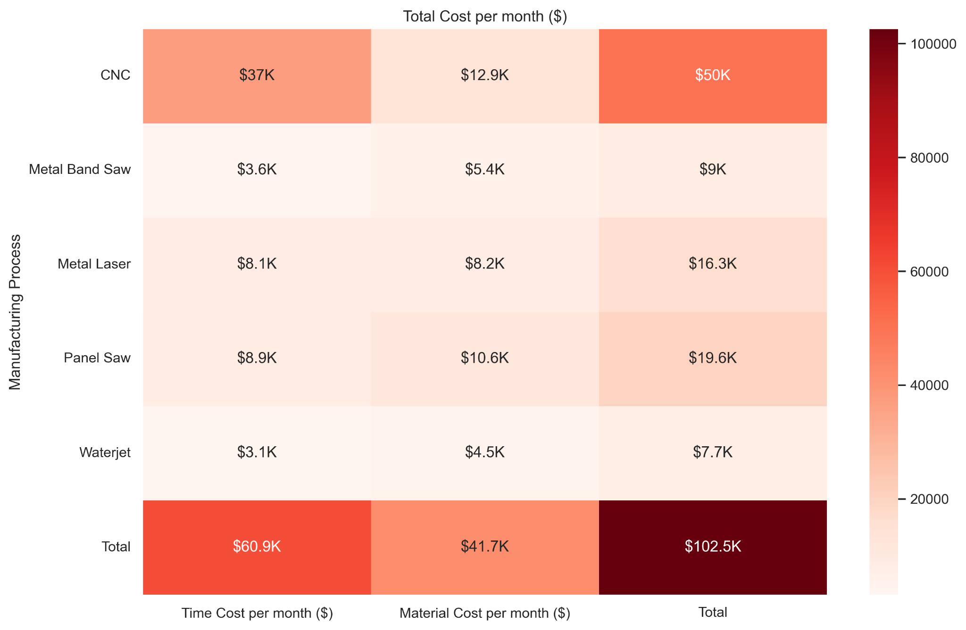
Business Problem
Notes:
Objective to result in the following
Not required to input material manually into a screen
Machines are predictable and can be trained to get it right.
<a href="https://www.flaticon.com/free-icons/human-error" title="human error icons">Human error icons created by Parzival’ 1997 - Flaticon</a>
<a href="https://www.flaticon.com/free-icons/down-time" title="down time icons">Down time icons created by Freepik - Flaticon</a>

Slide 5
Project objective
To develop a Convolutional Neural Network that can properly identify the required processes for each 3D modeled part.
Notes:
Explain a convolutional neural network, type of model that a data scientist can use that works well in image classification

Slide 6
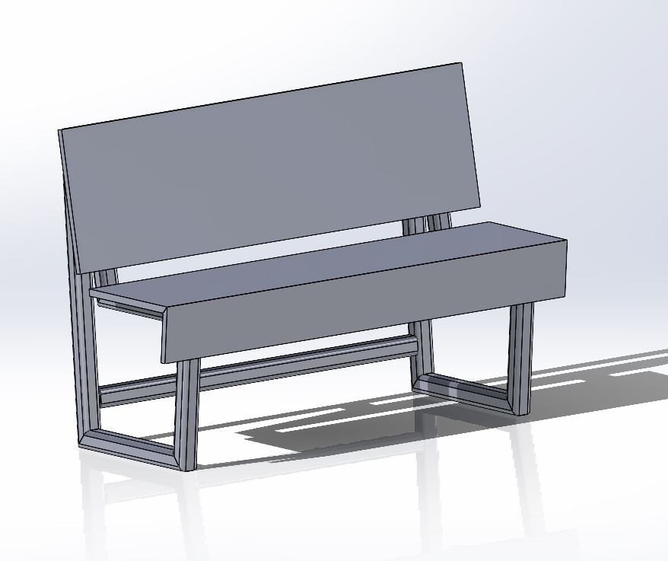
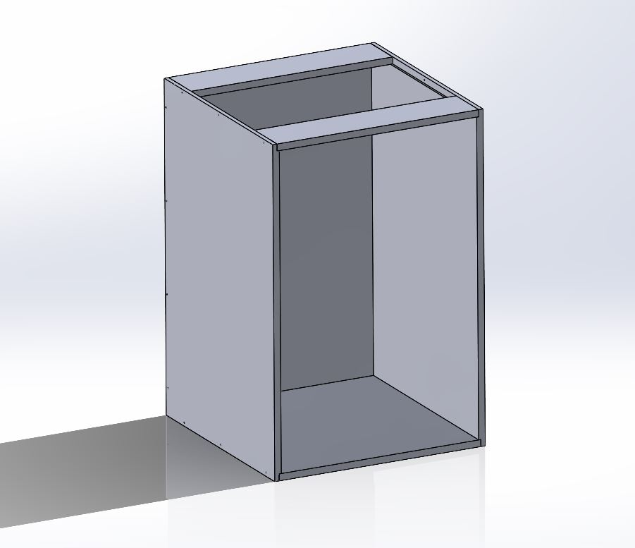
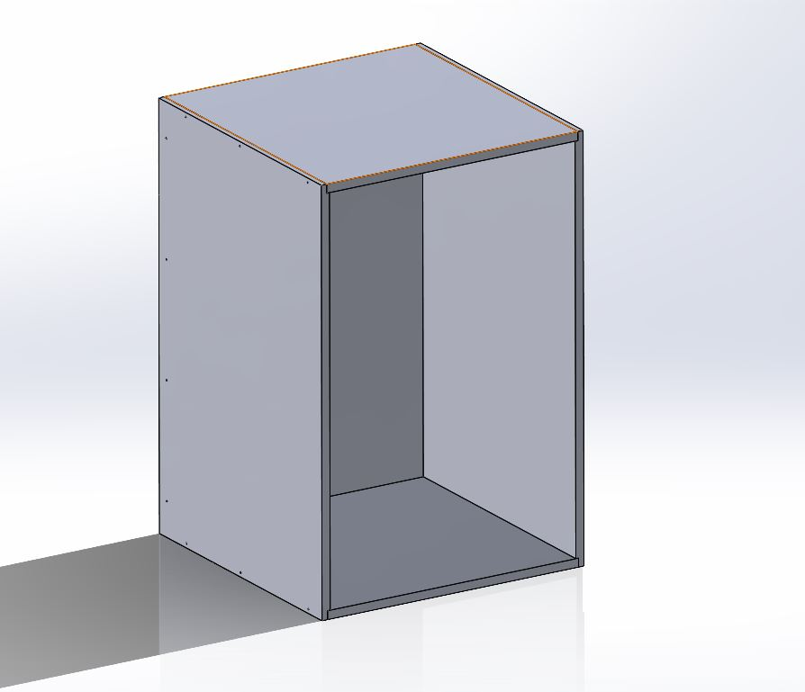
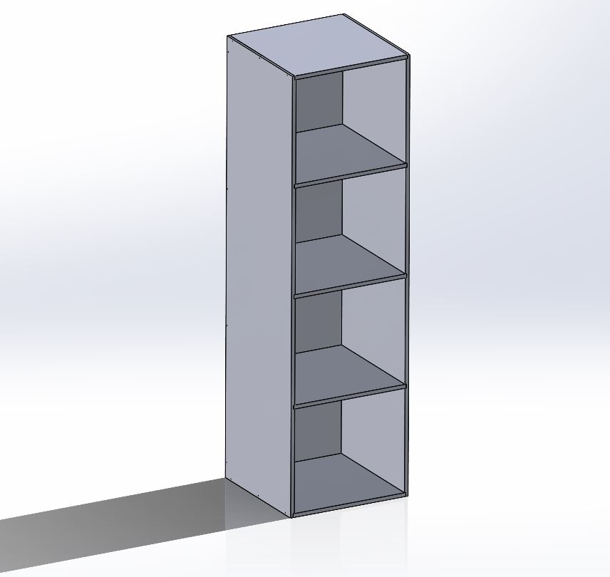
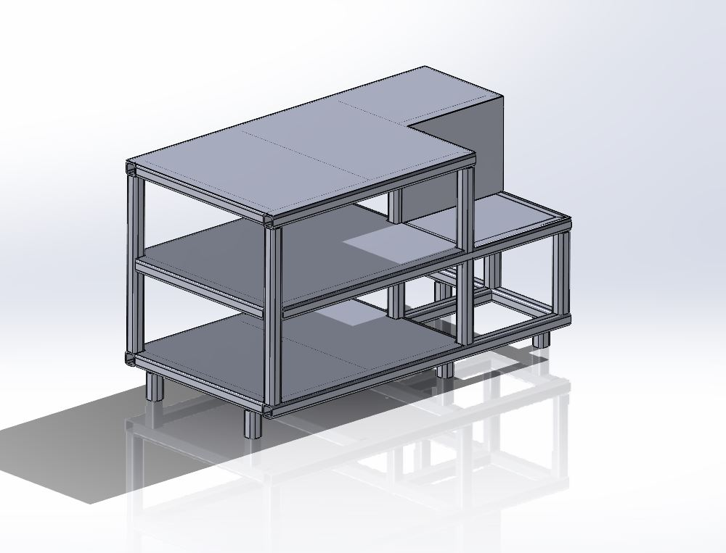
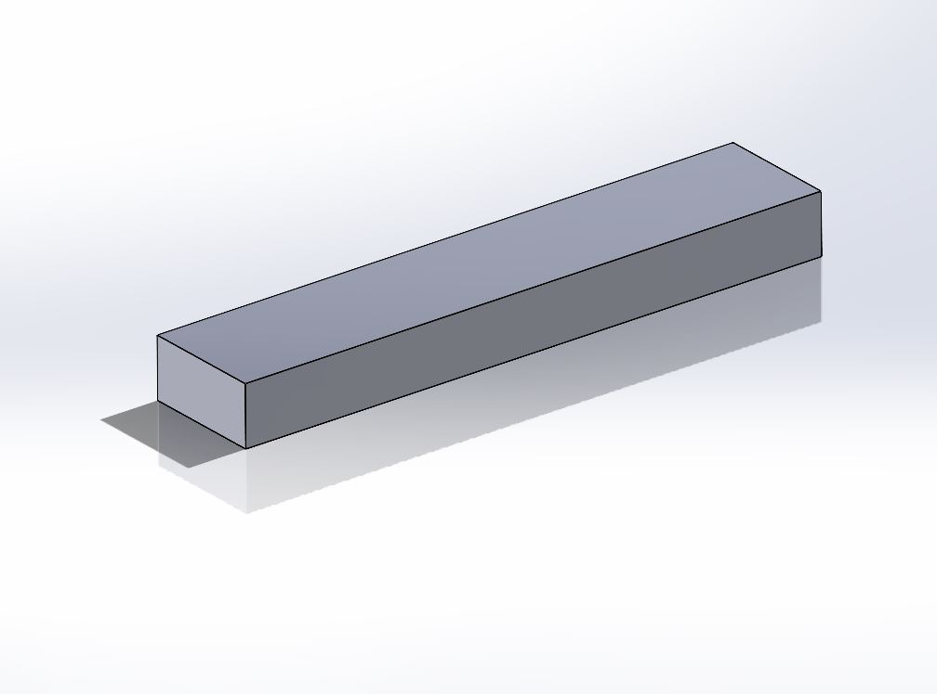
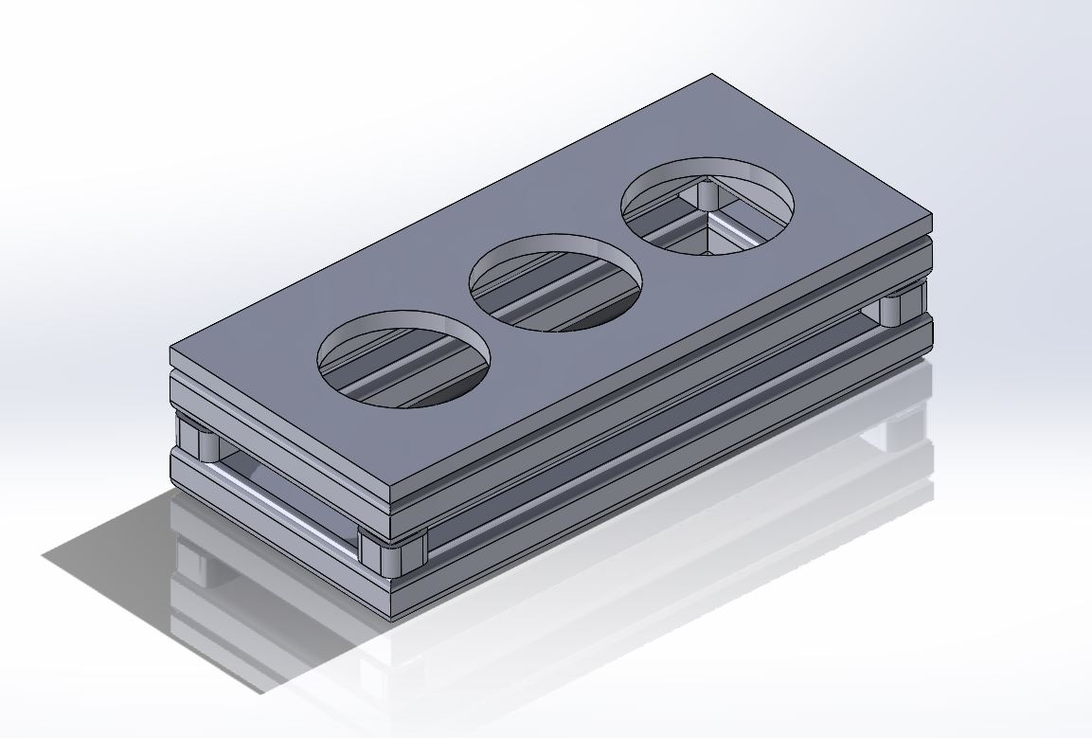
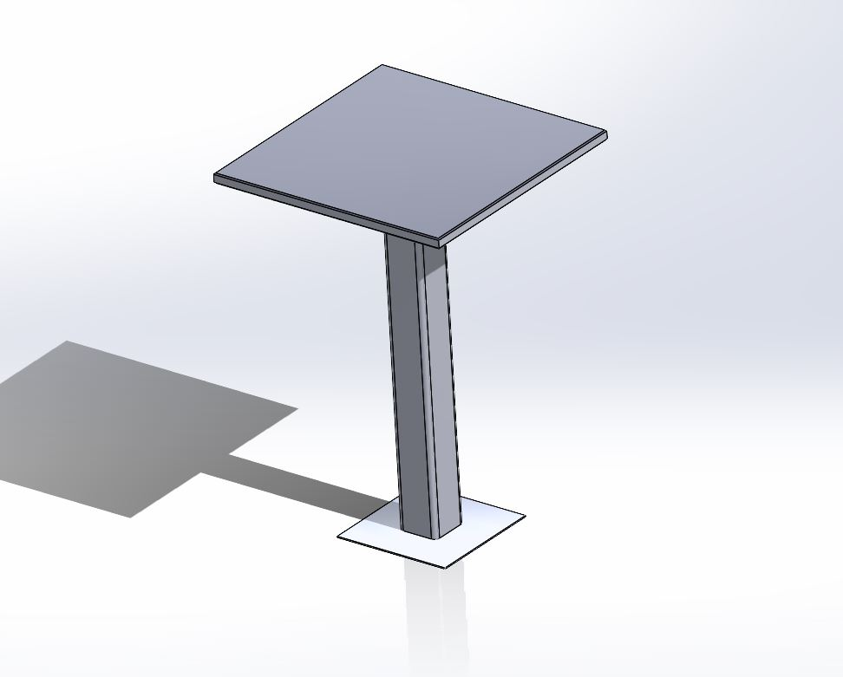
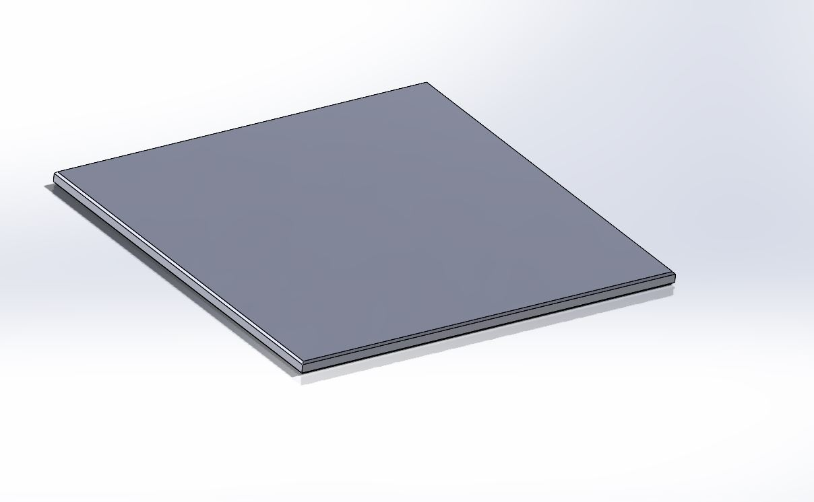
Data
Bench1
4 parts
16 configurations
Bench2
3 parts
21 configurations
Cab1
6 parts
8 configurations
Cab2
5 parts
32 configurations
Cab3
6 parts
28 configurations
Counter1
5 parts
15 configurations
Shelf1
1 part
96 configurations
Shelf2
6 parts
14 configurations
Station1
2 parts
18 configurations
Table1
2 parts
28 configurations
Notes:
Images taken over the course of one day at the facility.

Slide 7
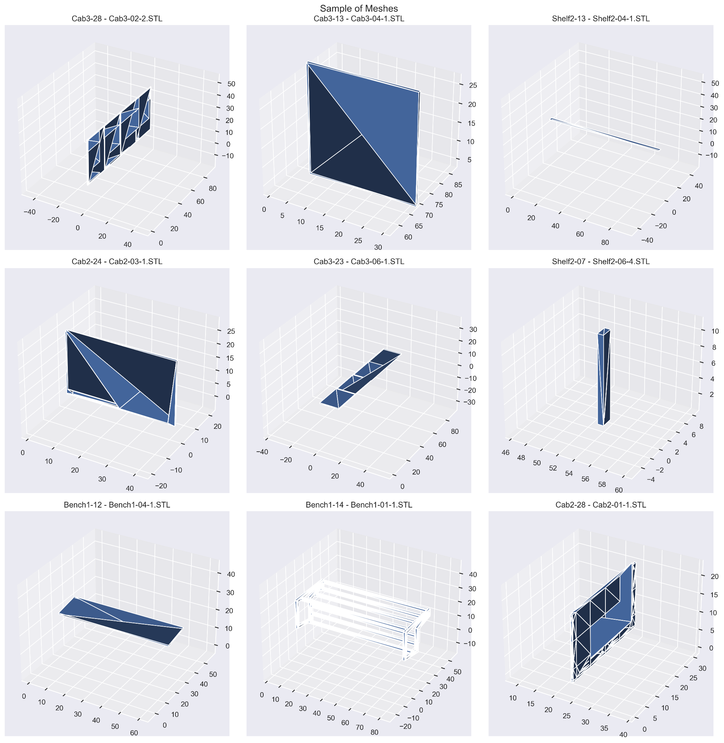
Data Collection
Meshes show a variety of shapes from different parts
Human identified class of cutting manufacturing process
Notes:
Images taken over the course of one day at the facility.

Slide 8
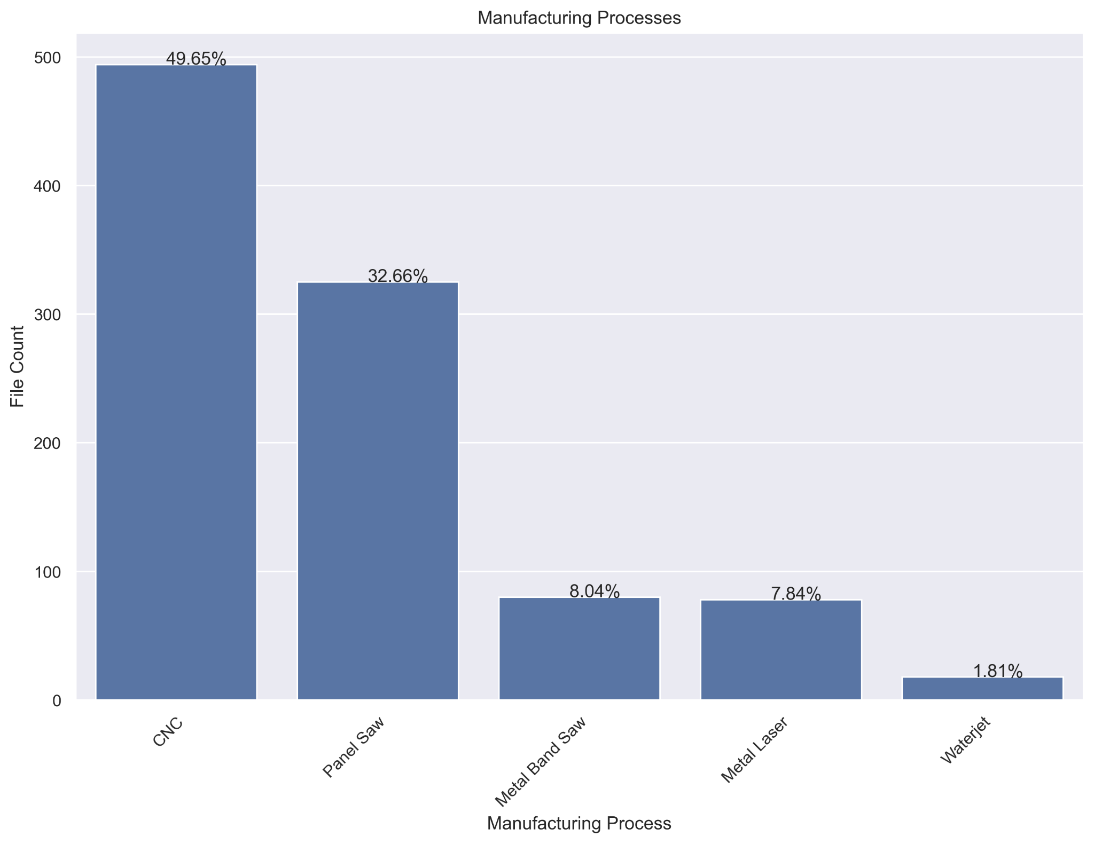
Data
995 parts model in total, divided into 5 classes
CNC and Panel Saw are the most common processes used at the machine to cut material
Notes:
Image data collected on a iphone 13 over one day period
Explain each class

Slide 9
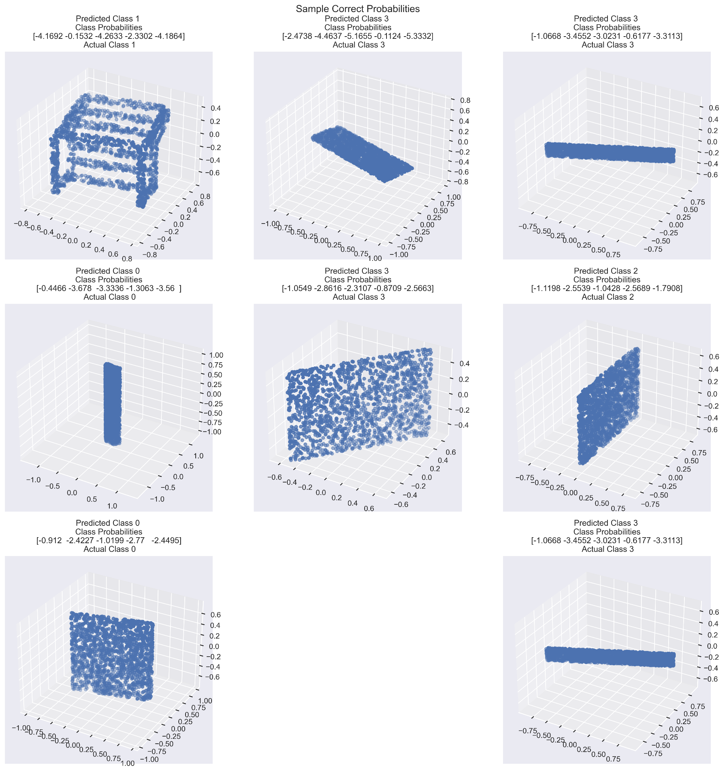
Data - Correct
Correct meshes show metal weldments and flat panels

Slide 10
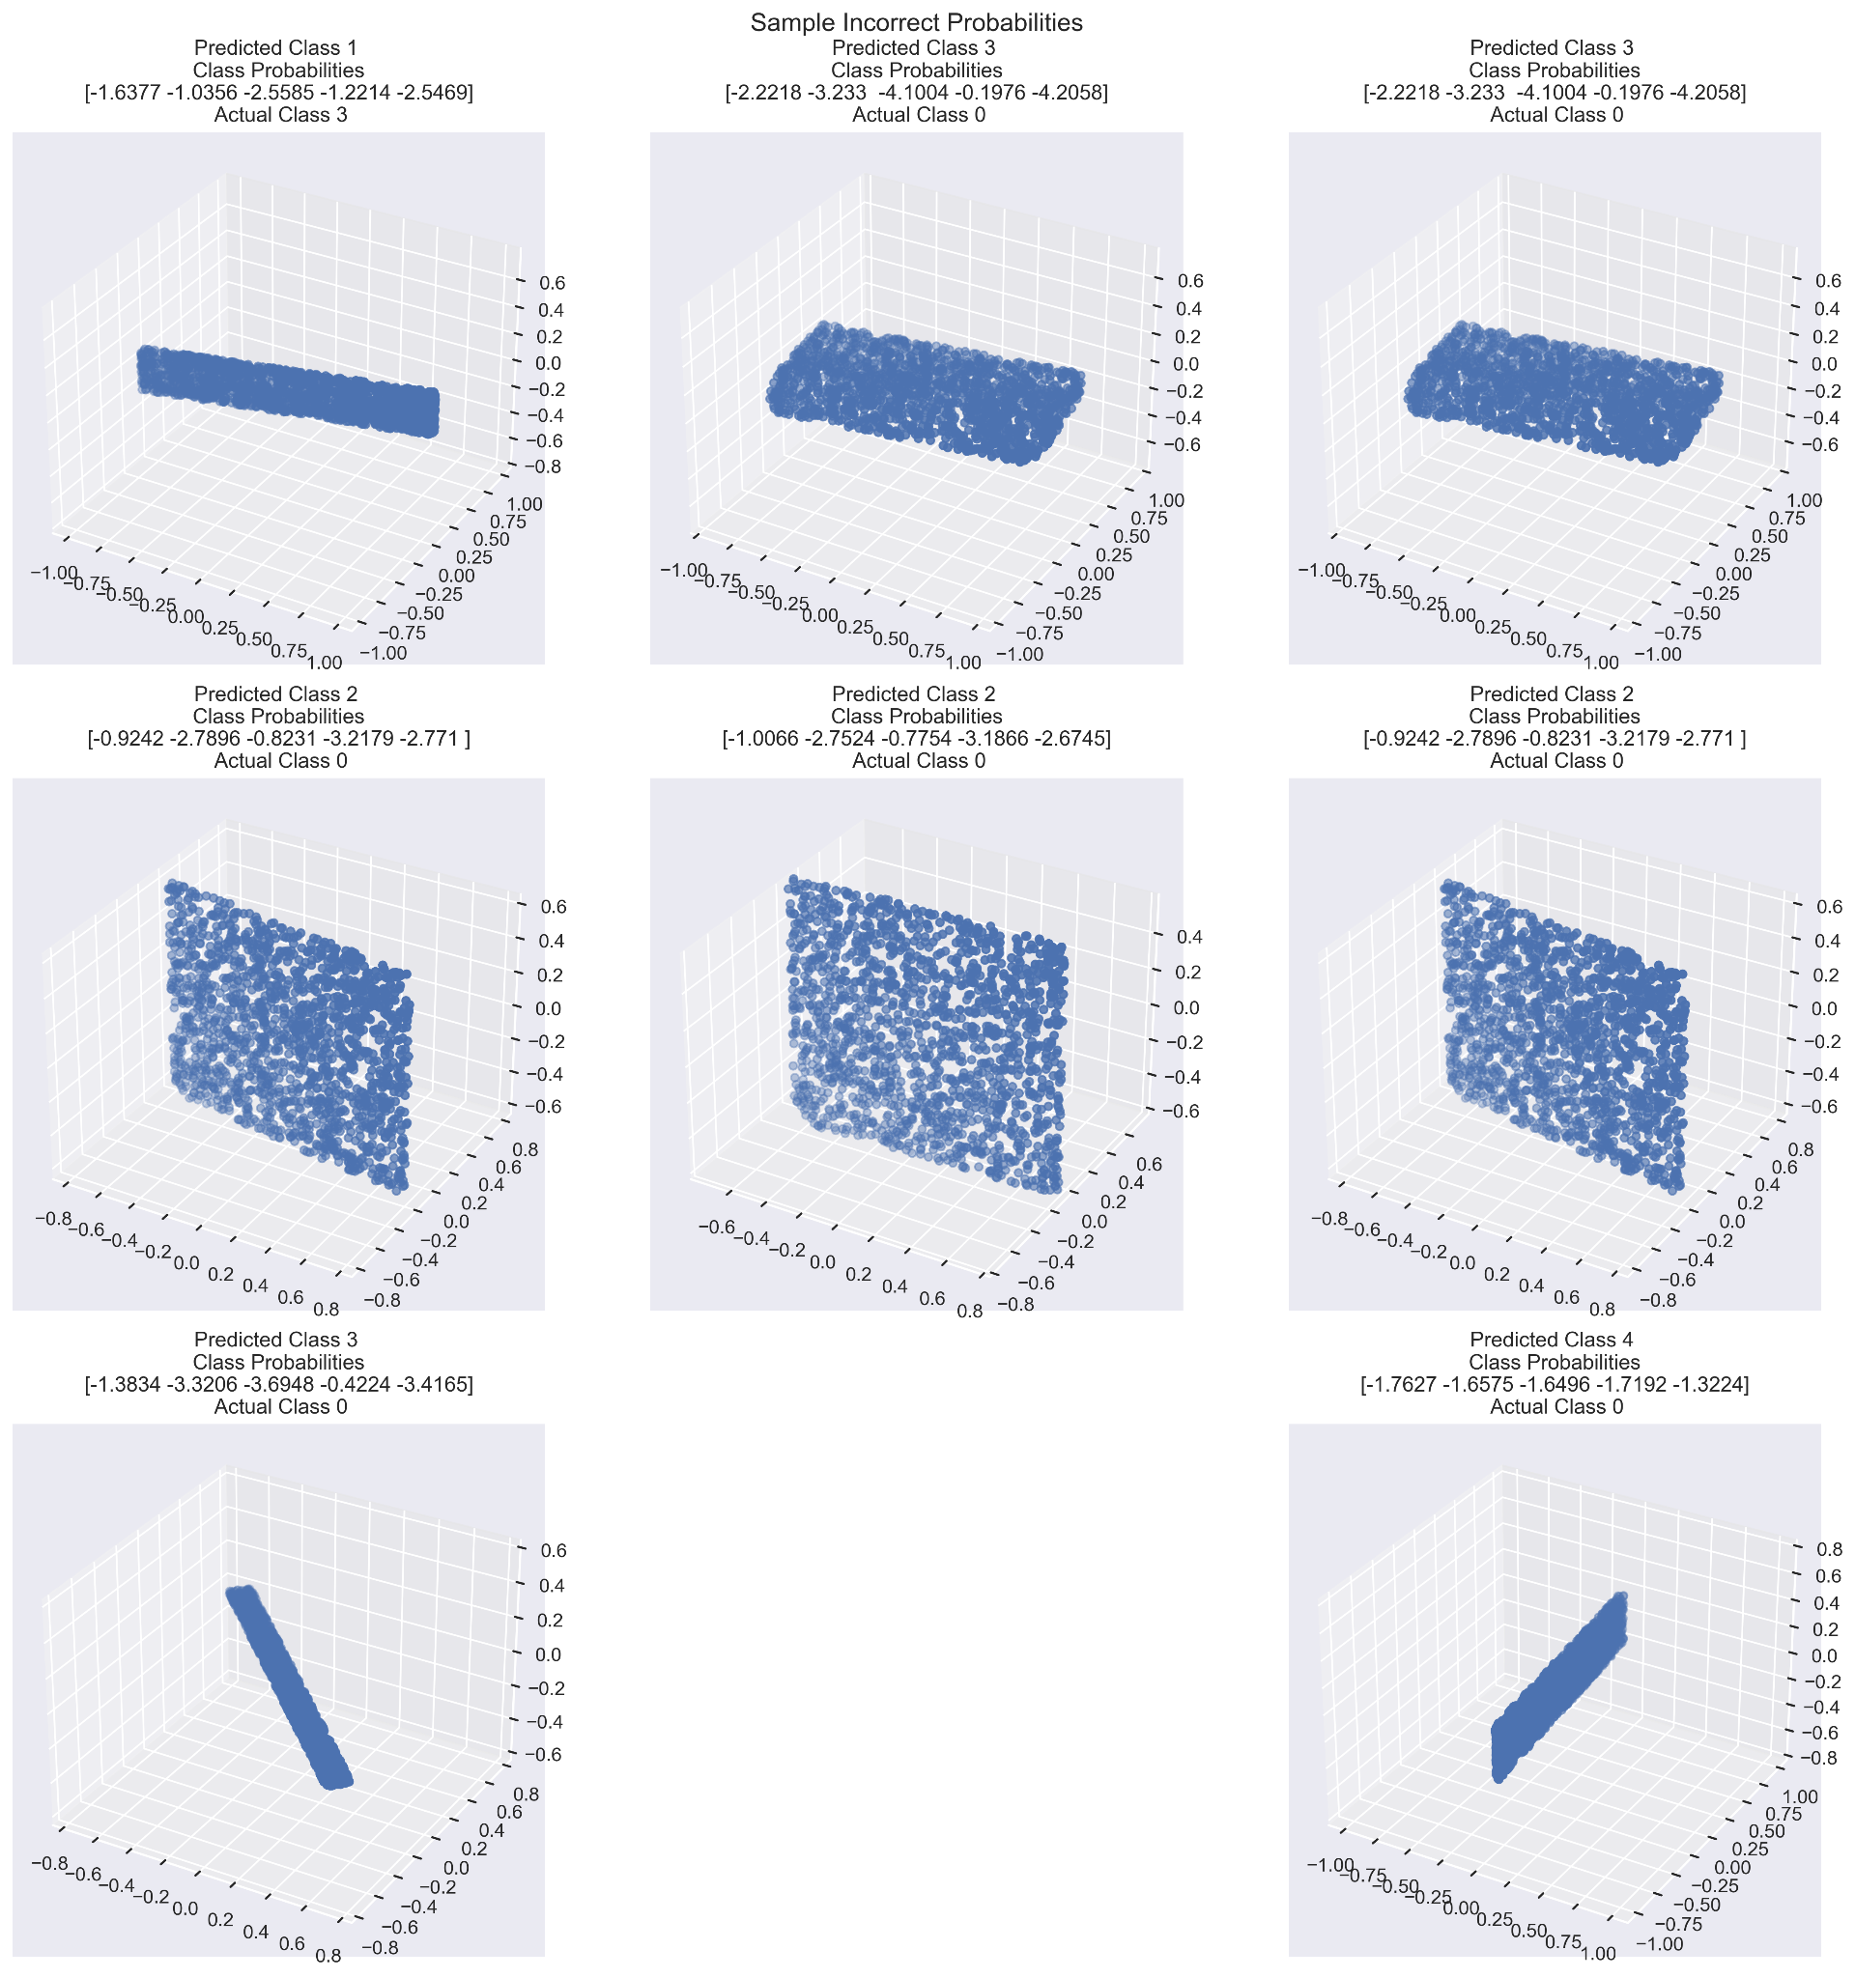
Data - Incorrect
Most mispredictions in CNC (0) class
Material feature integrated into model would fix mispredictions with Metal Laser (2) and Metal Band Saw (1)
The Mesh faces integrated into a different model architecture would fix mispredictions with Panel Saw (3)
Incorrect images show images which have varied issues to be dealt with:

Slide 11
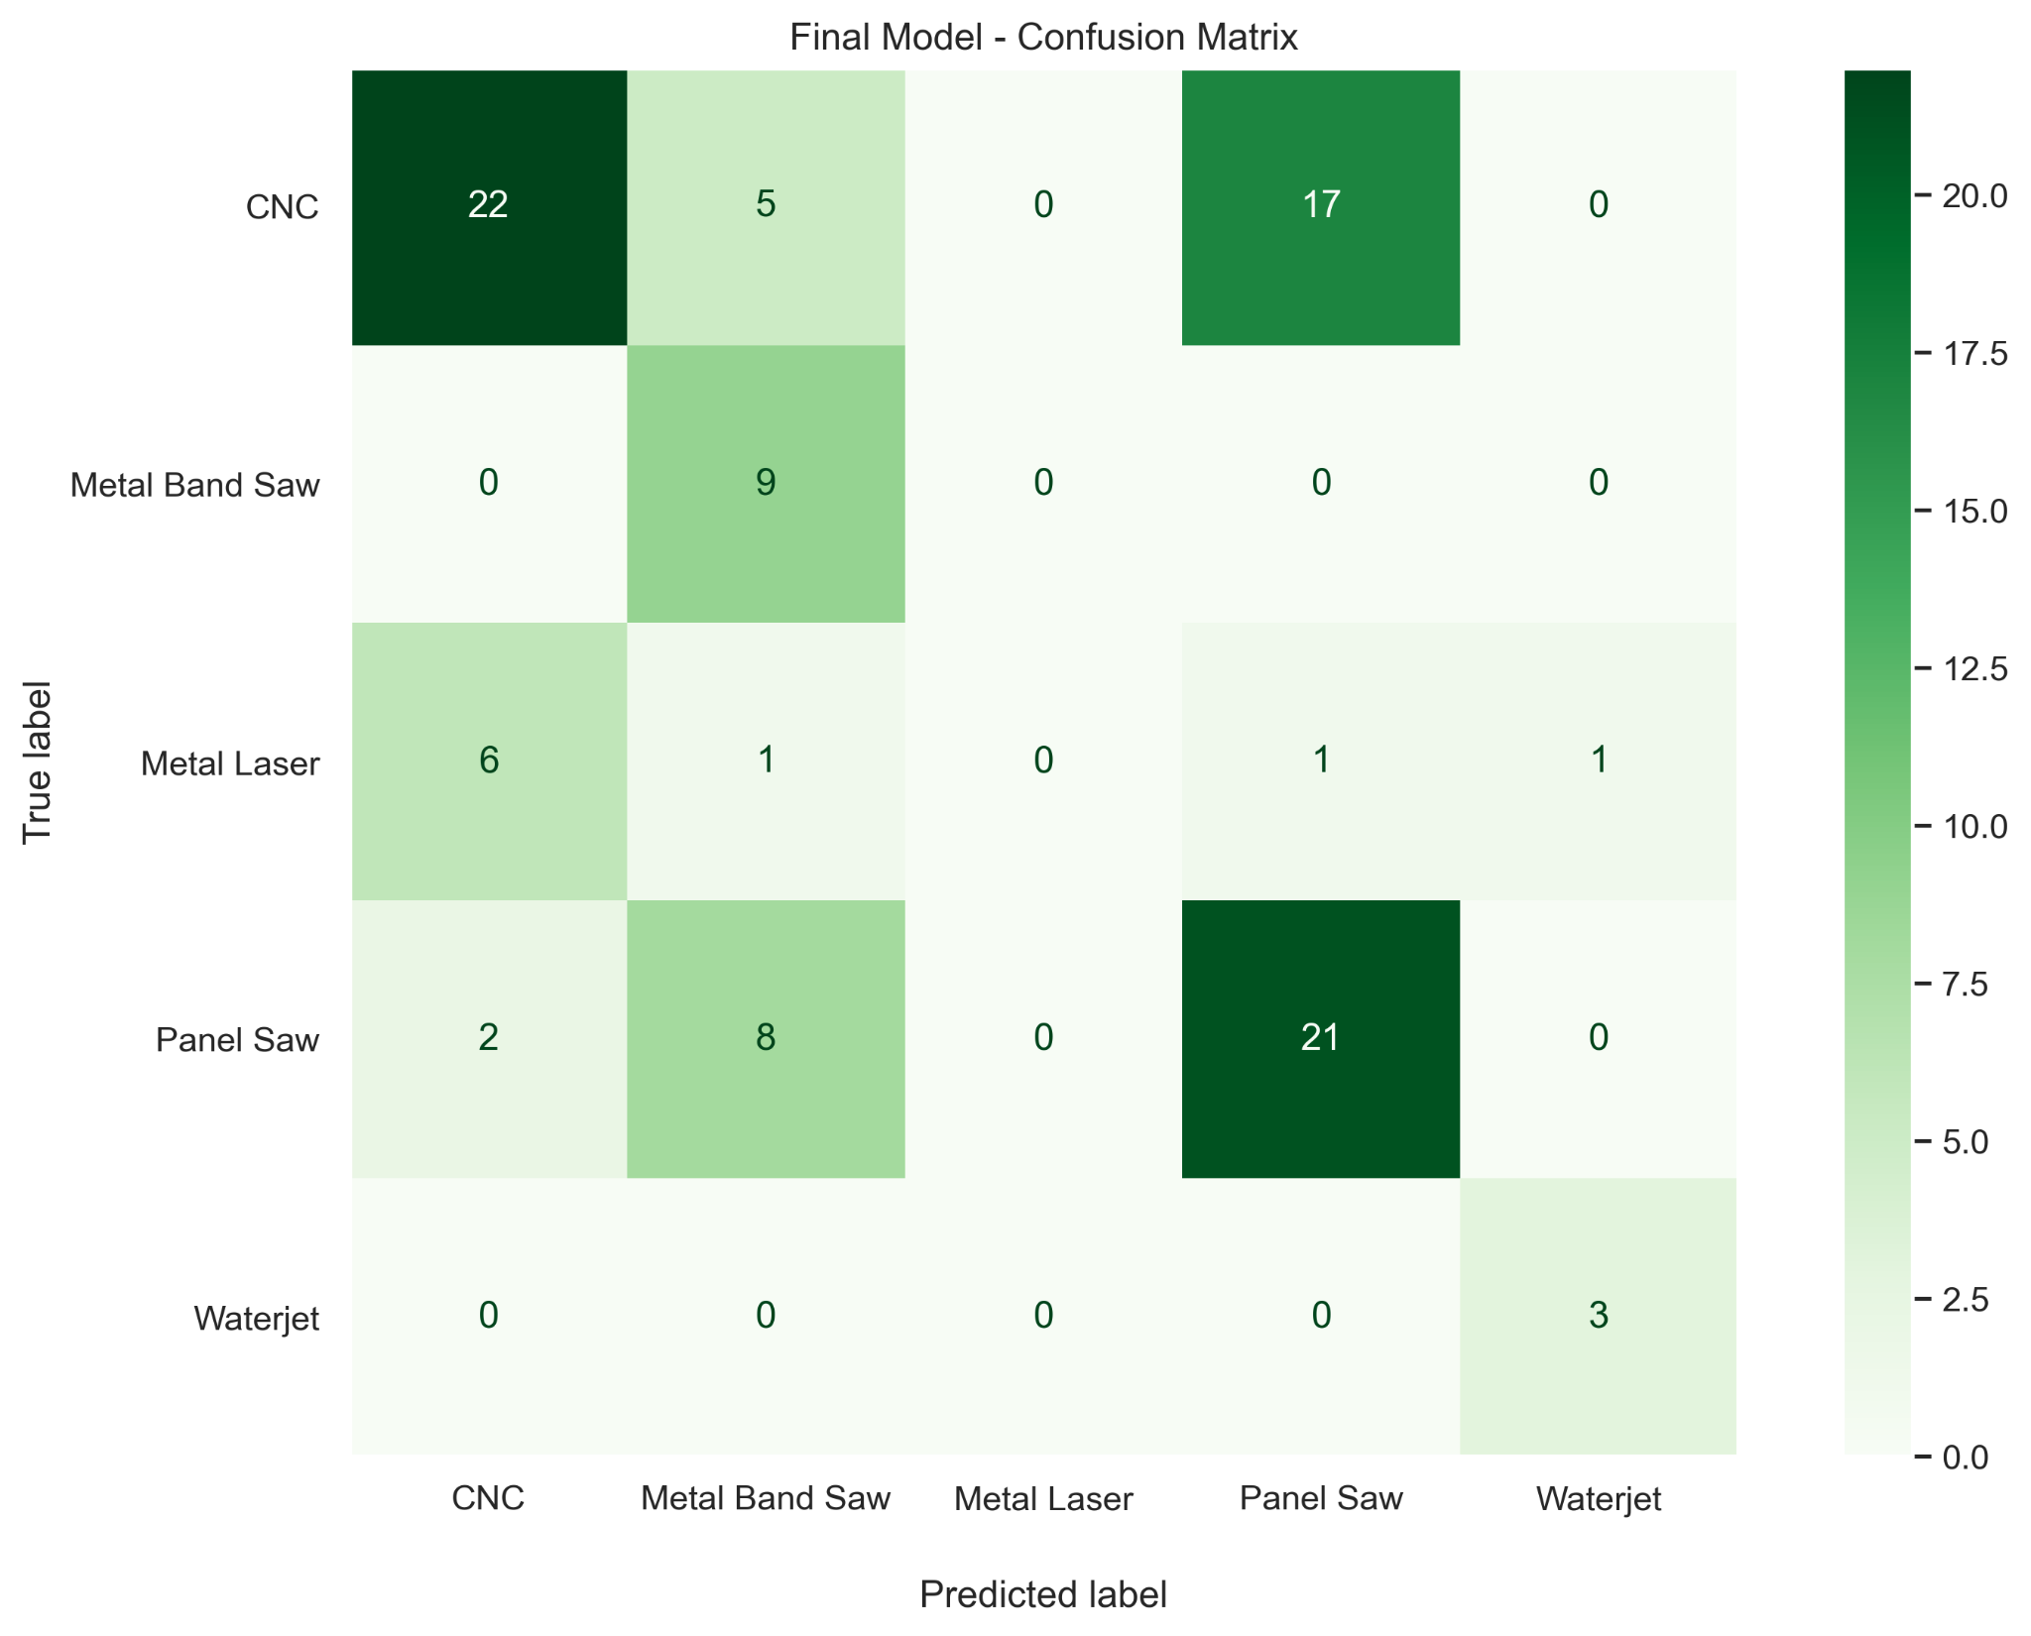
Results
Metrics
Total of 96 items in test set
CNC Precision at 73%
CNC recall at 50% and F1-score at 59%
Notes:
Explain confusion matrix
Predicted label on the bottom, true label on the side

Slide 12
Recommendations - Implementation
Model can be implemented for designating CNC processes with engineering supervision
Human assignment should happen for all items identified as not CNC by the algorithm.
Manual assignment to the CNC class needs to be triple checked
An assignment flow diagram should be given to an administrative member to handle assignments
Model shall be improved over a 90 day period, after which full deployment for all 5 classes would be possible.

Slide 13
Next Steps
1
2
3
Increase amount of data to train on by using 10,000 or 20,000 3D models
Gather more accurate measurements on machine time from the factory rather than provided estimates
Better accuracy could be obtained by utilizing other types of neural network architectures (not only analyzing pointclouds)
4
5
Integrate materials into the modeling
Gather more accurate measurements for material square footage from the models rather provided estimates

Slide 14
THANK YOU

Slide 15
APPENDIX

Slide 16
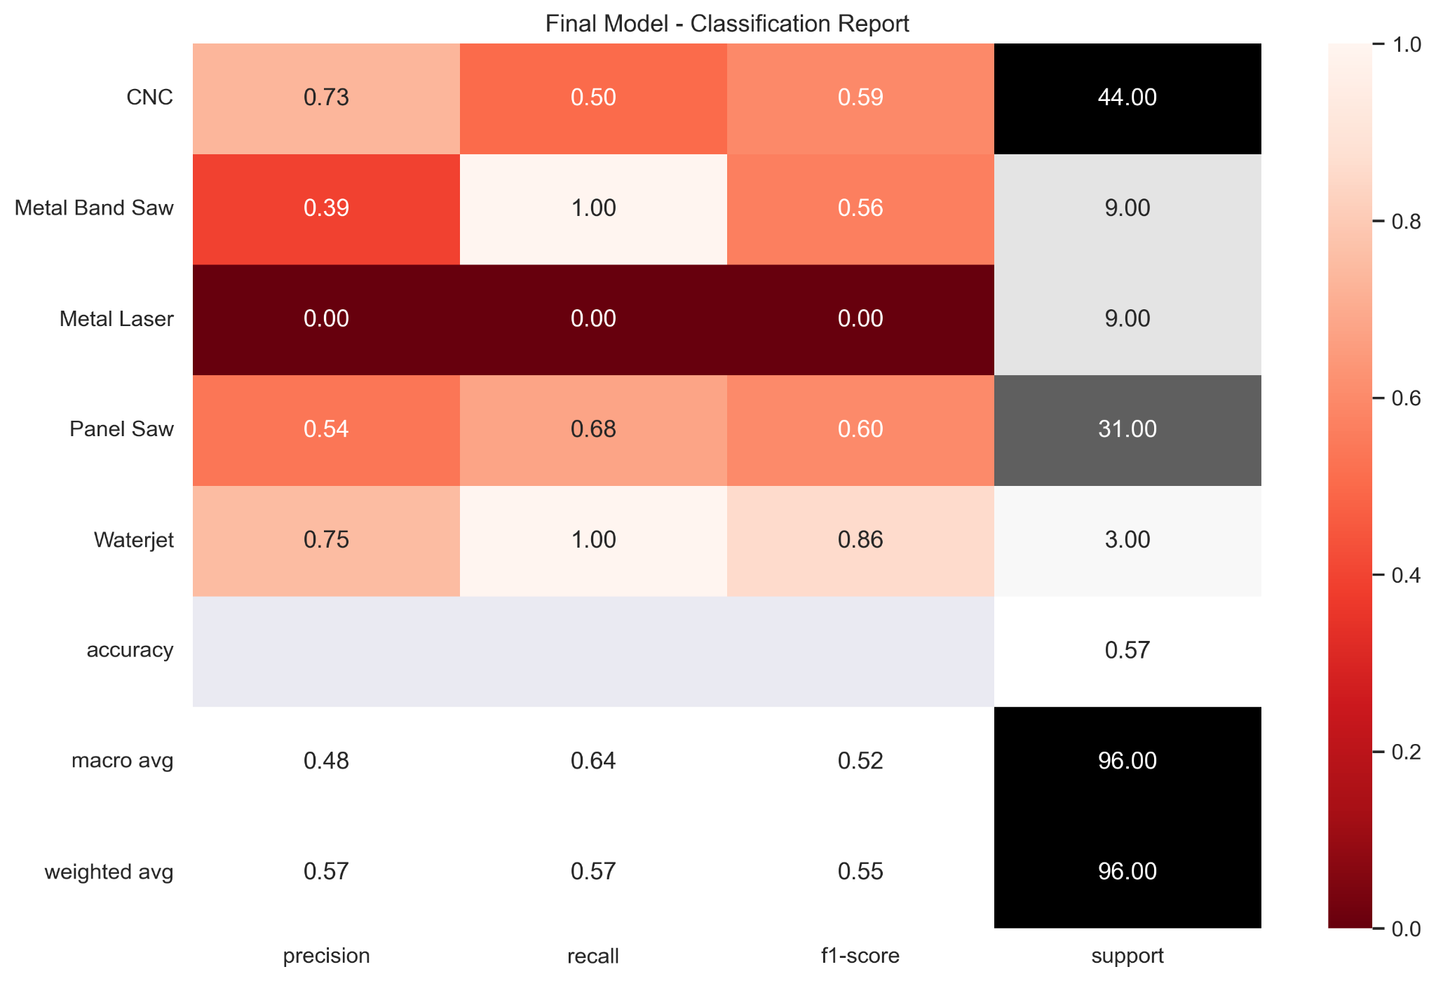
Data - Final Model
Precision for CNC is perfect
High values overall metrics without data augmentation

Slide 17
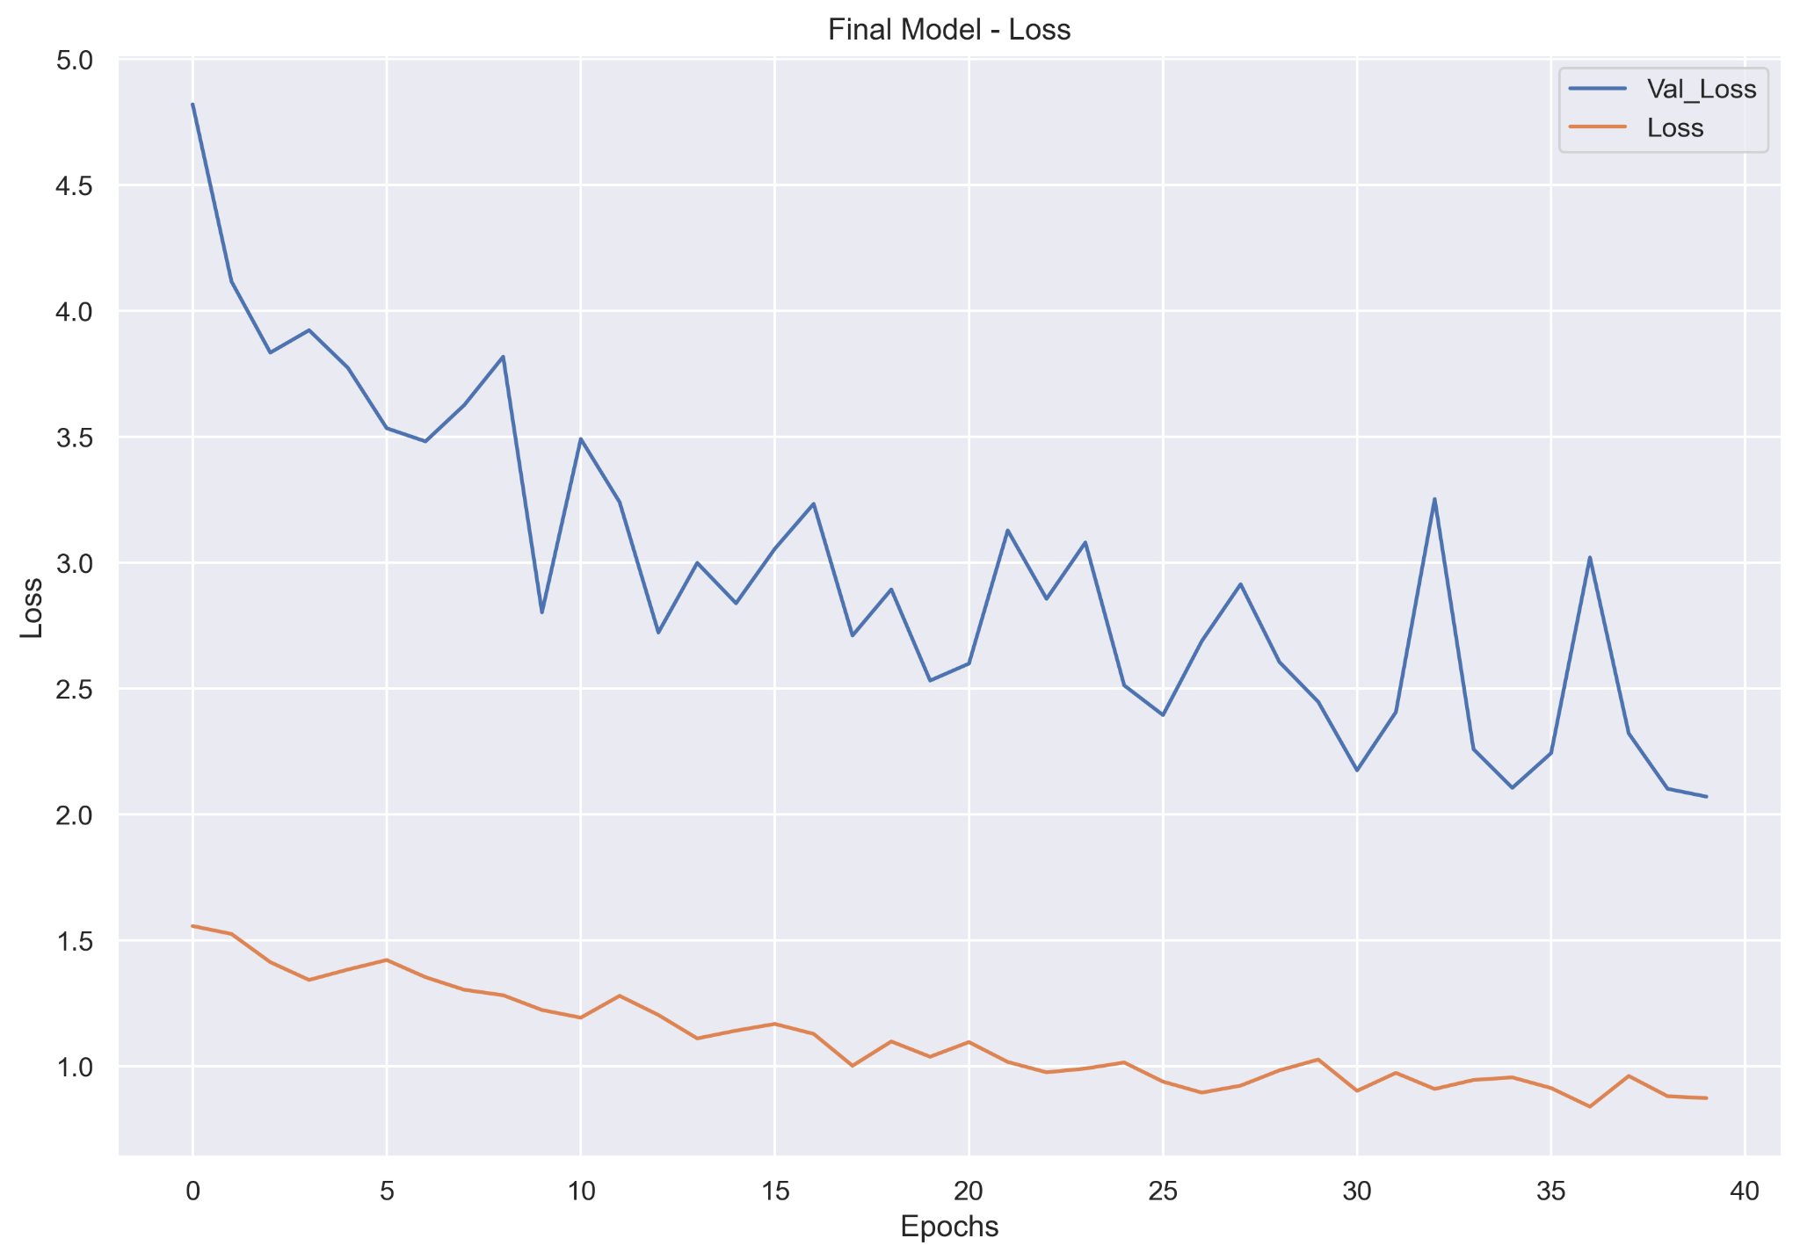
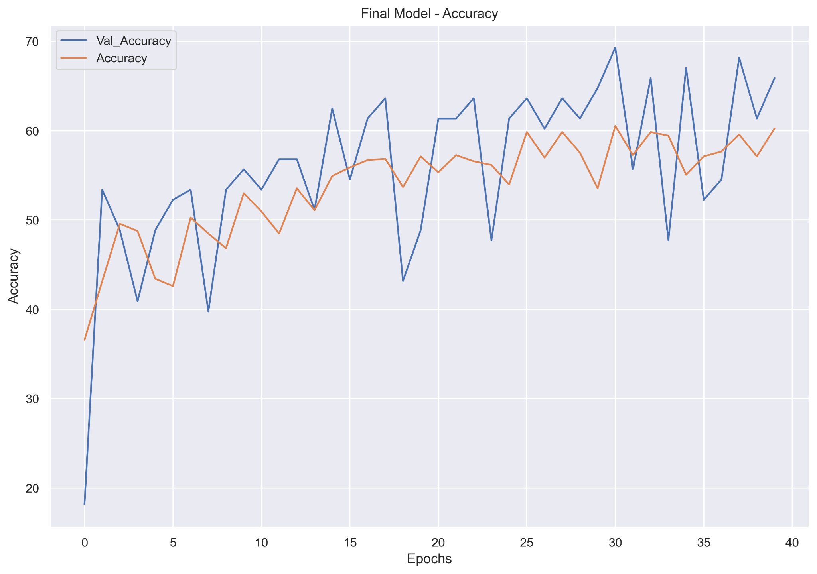
Data - Final Model
Loss improving over time
Accuracy improving over time

Slide 18
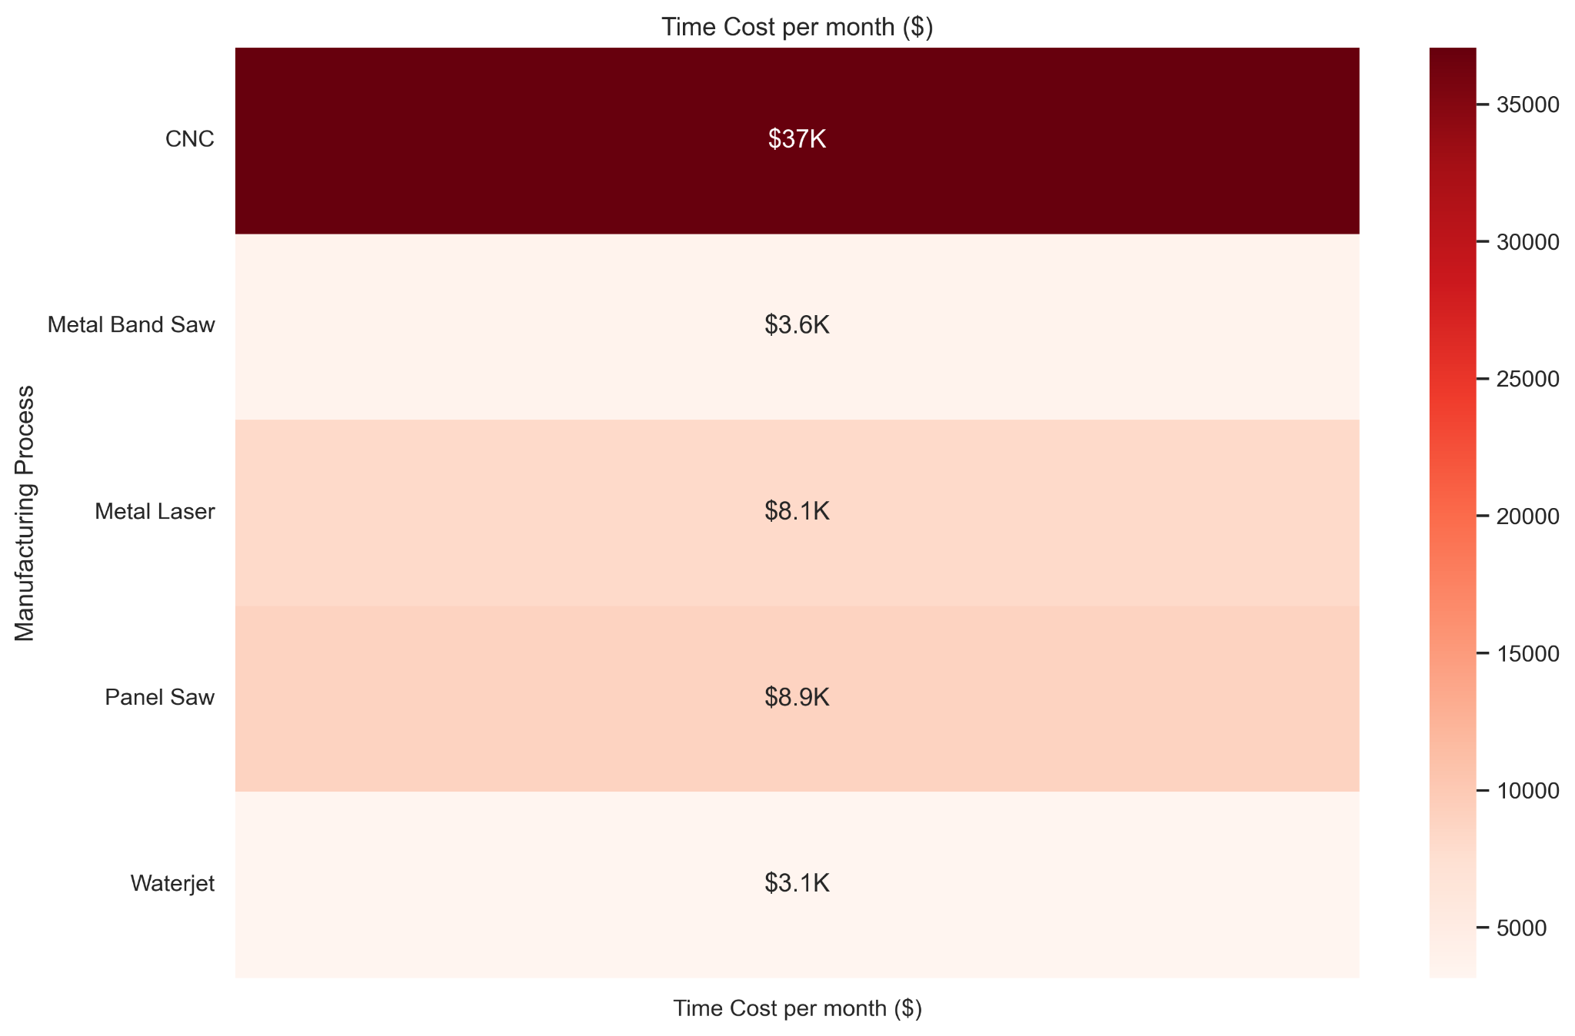
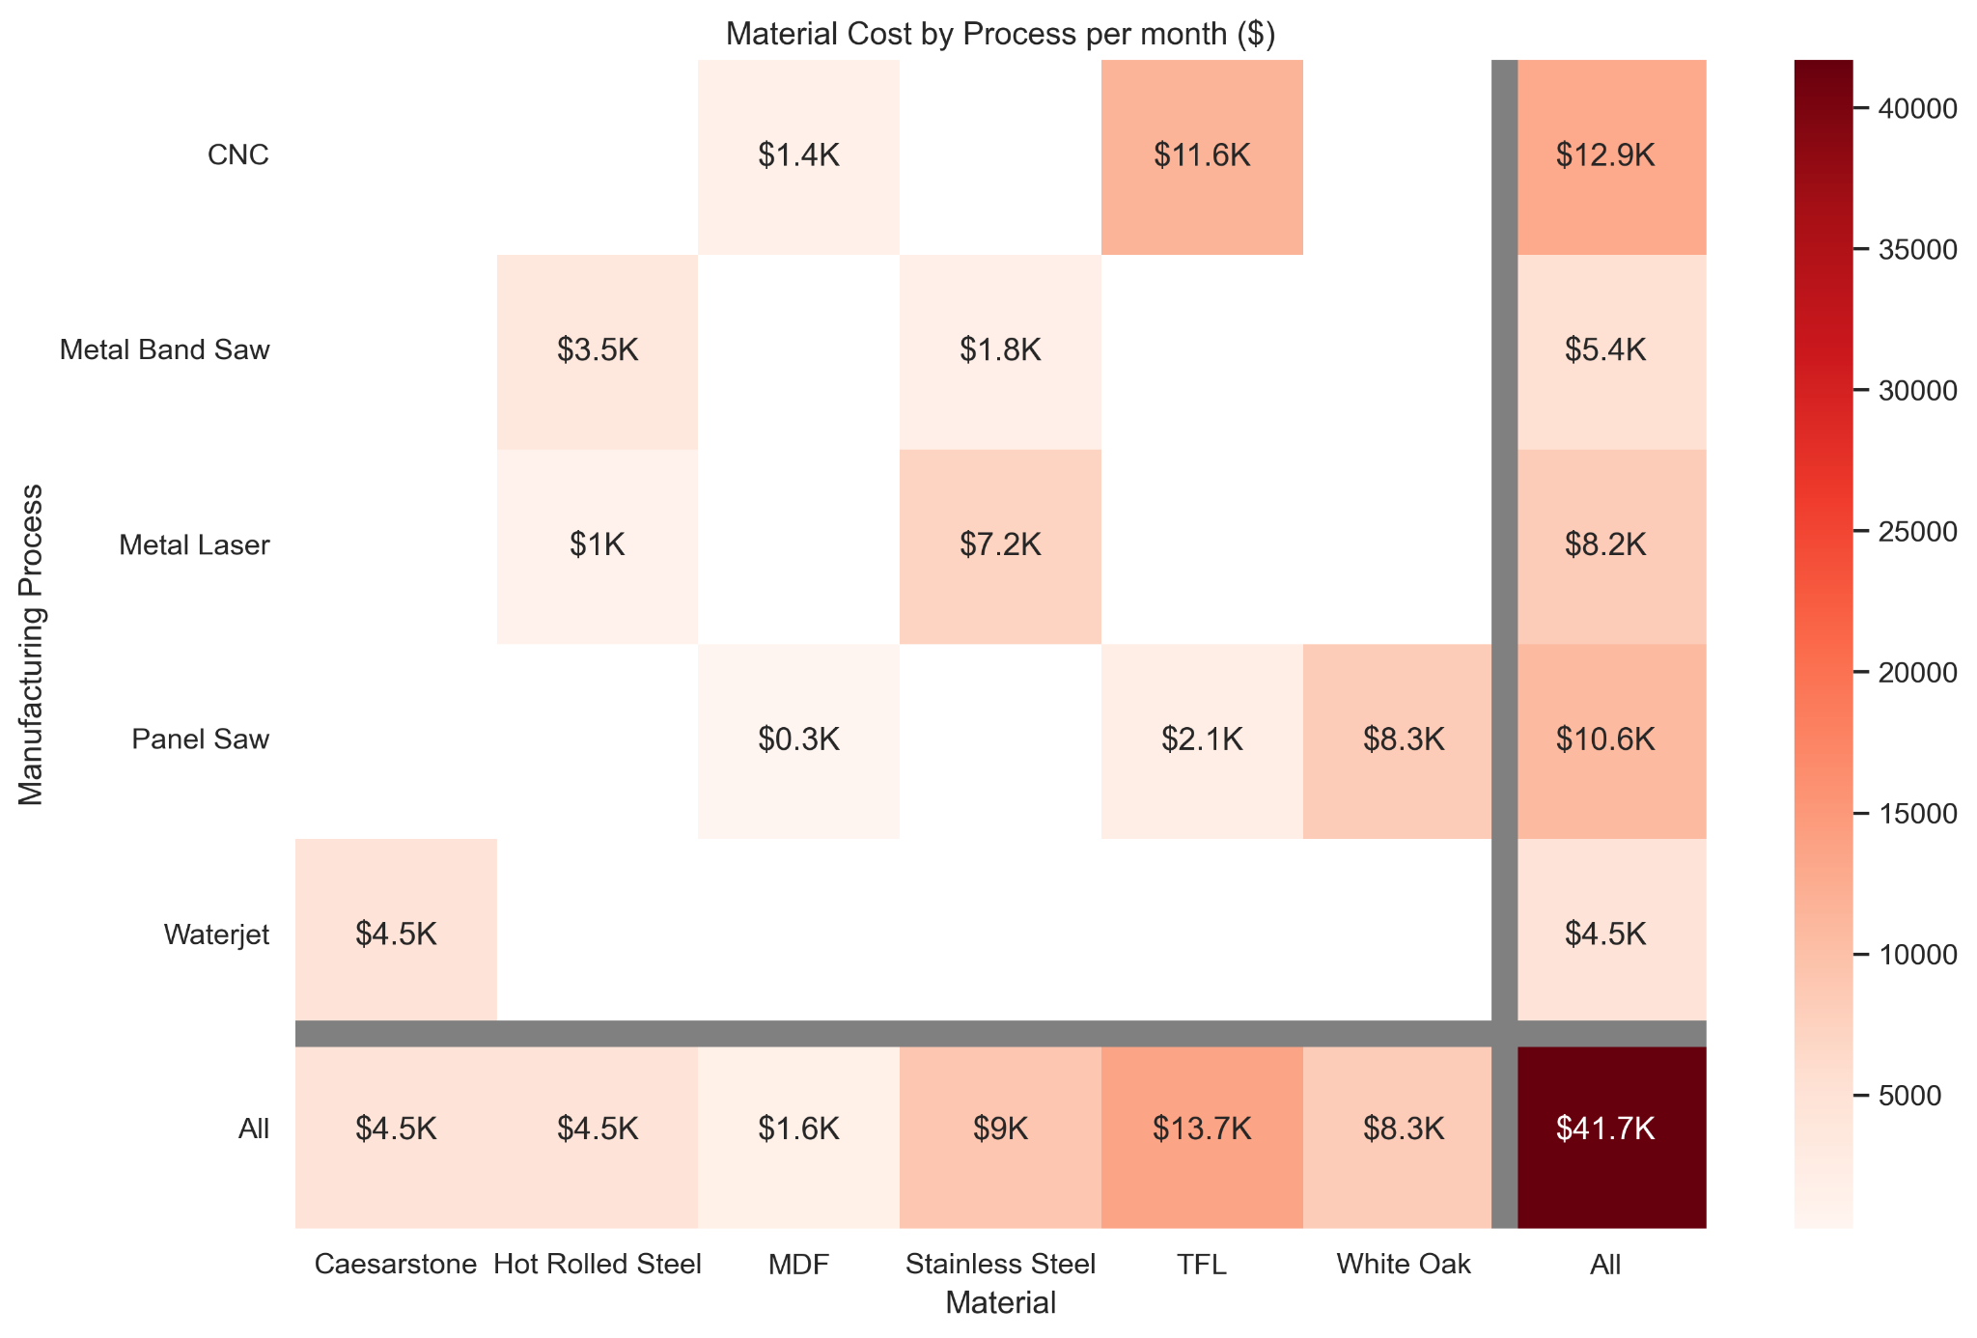
Data - Time Material Cost
CNC highest time cost
TFL highest spending
CNC highest material cost

Slide 19
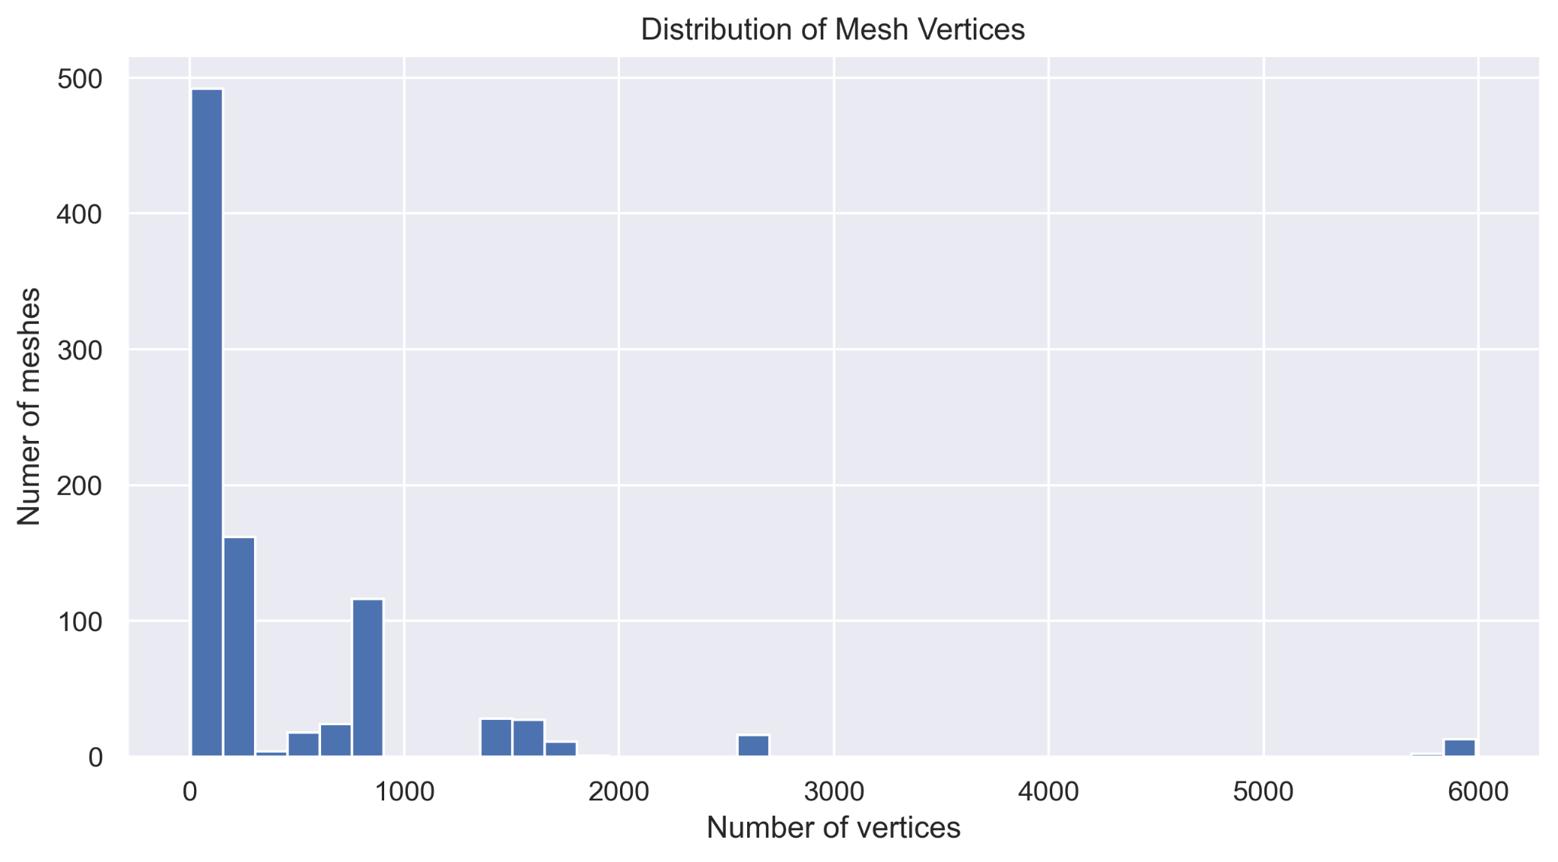
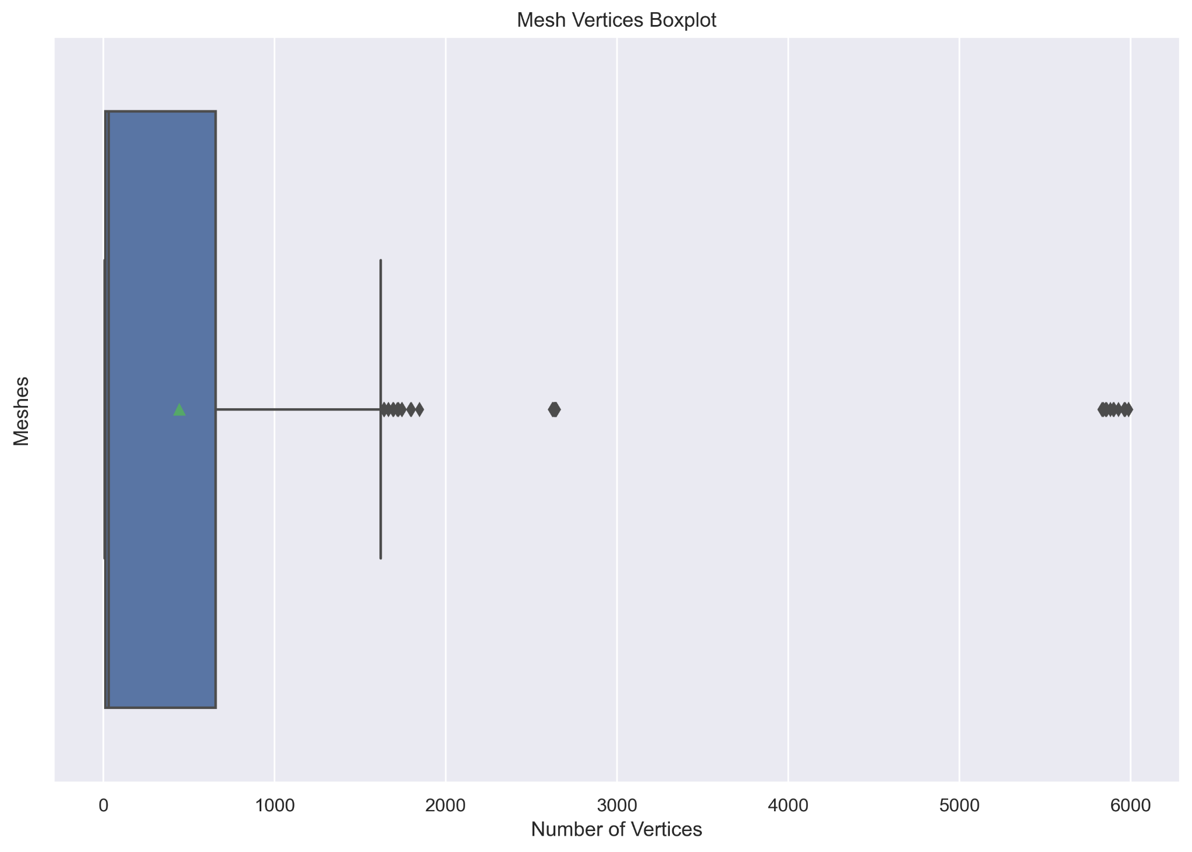
Data - Mesh Vertices
Wide variance in mesh vertices
Outliers at 6000 and 2600 vertices

Slide 20
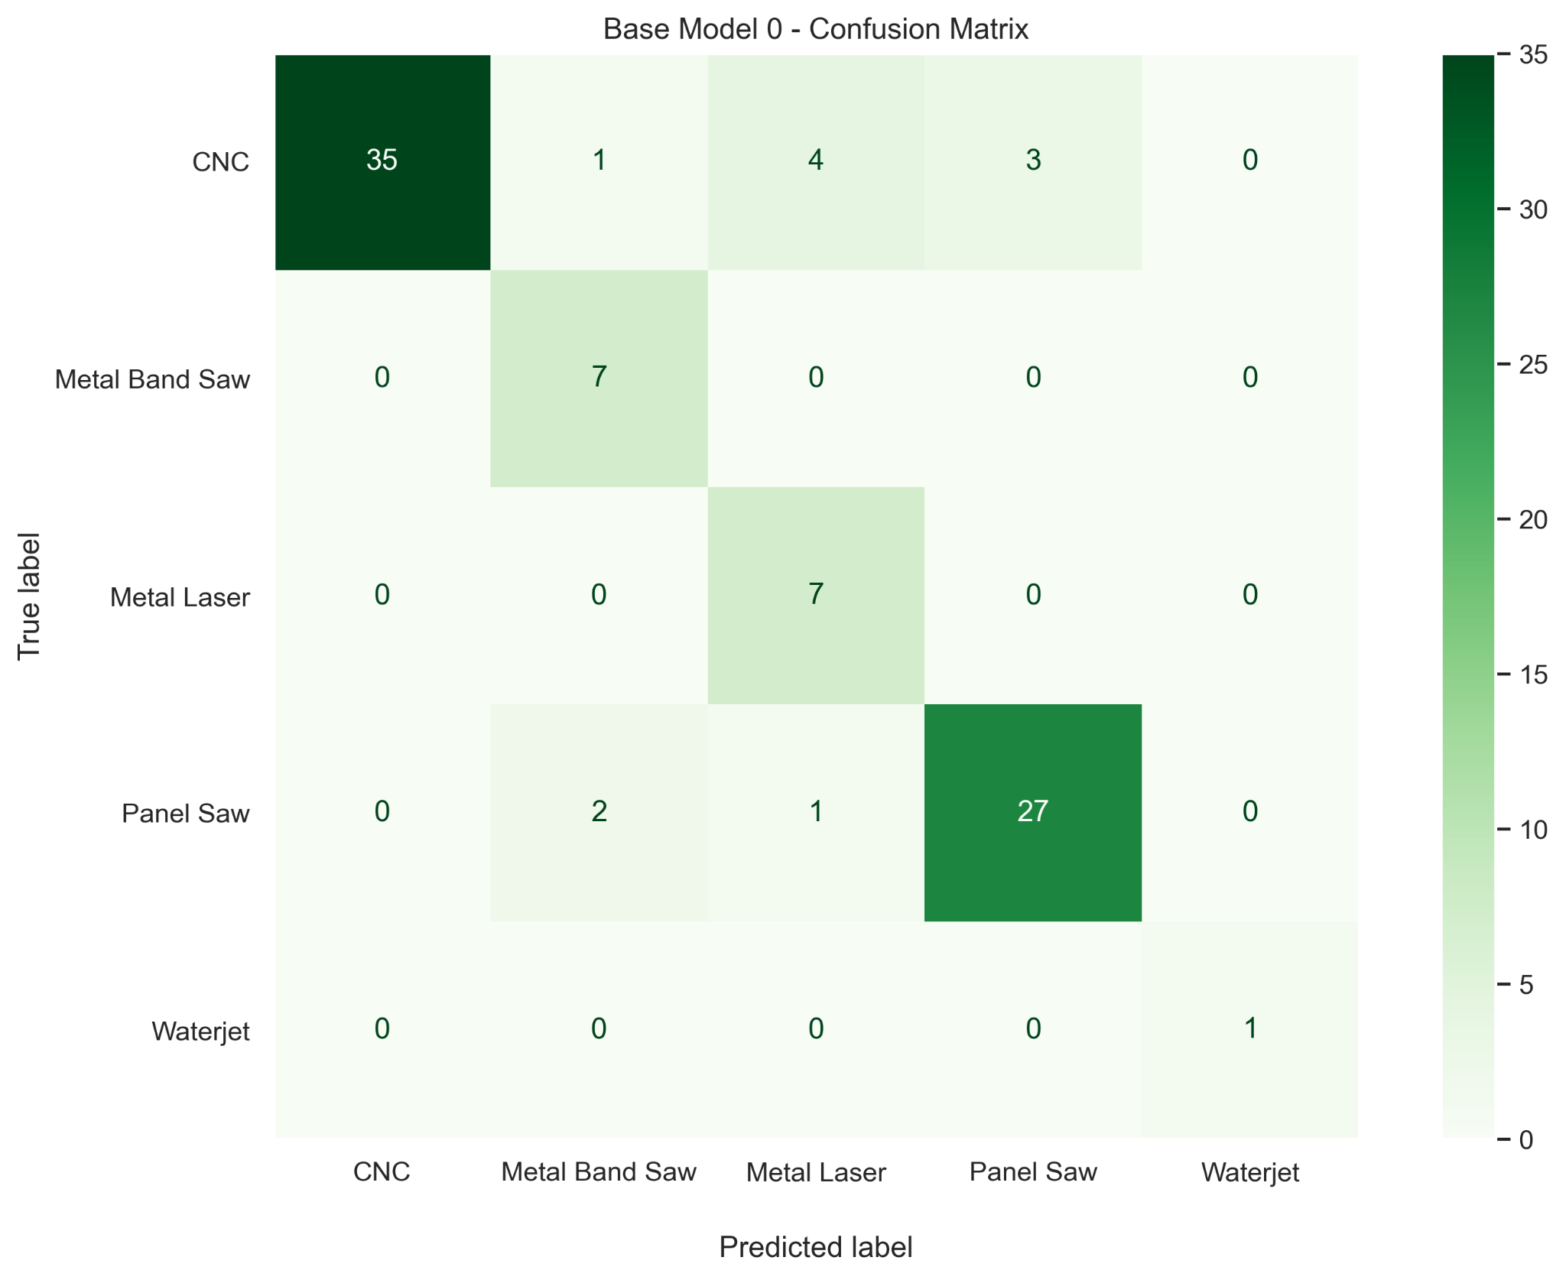
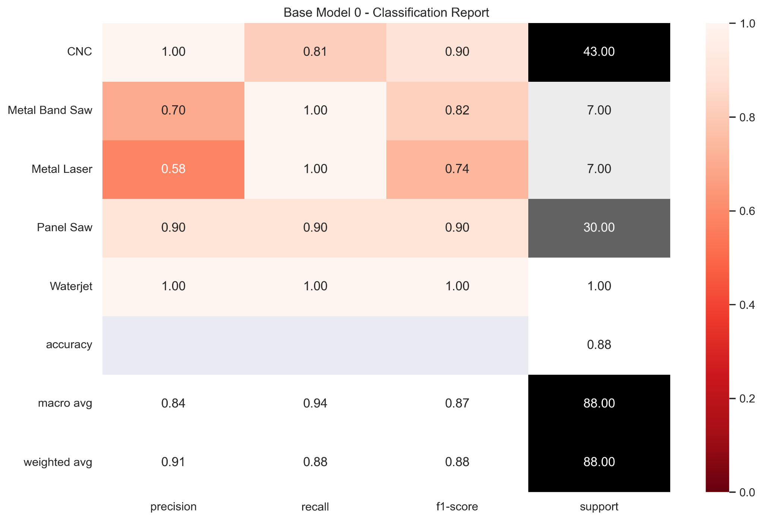
Data - Base Model
Precision for CNC is perfect
High values overall metrics without data augmentation

Slide 21
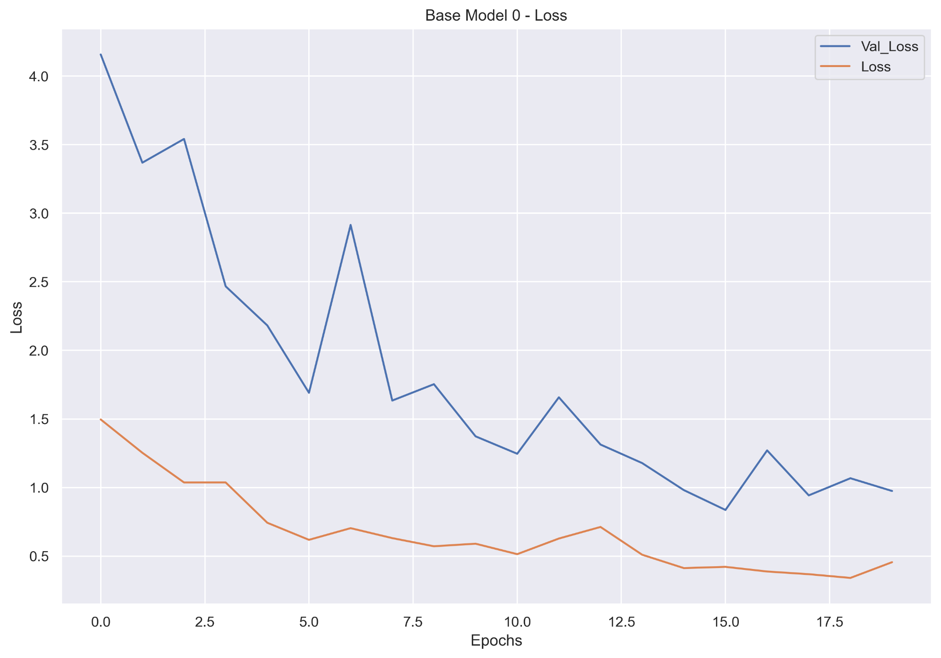
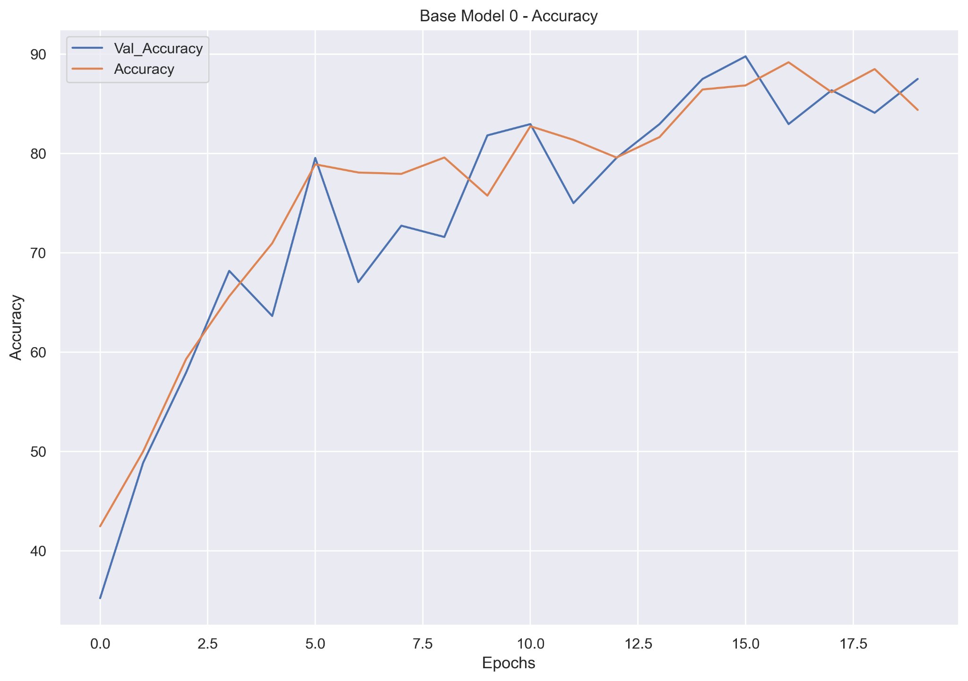
Data - Base Model
Loss improving over time
Accuracy improving over time

Slide 22
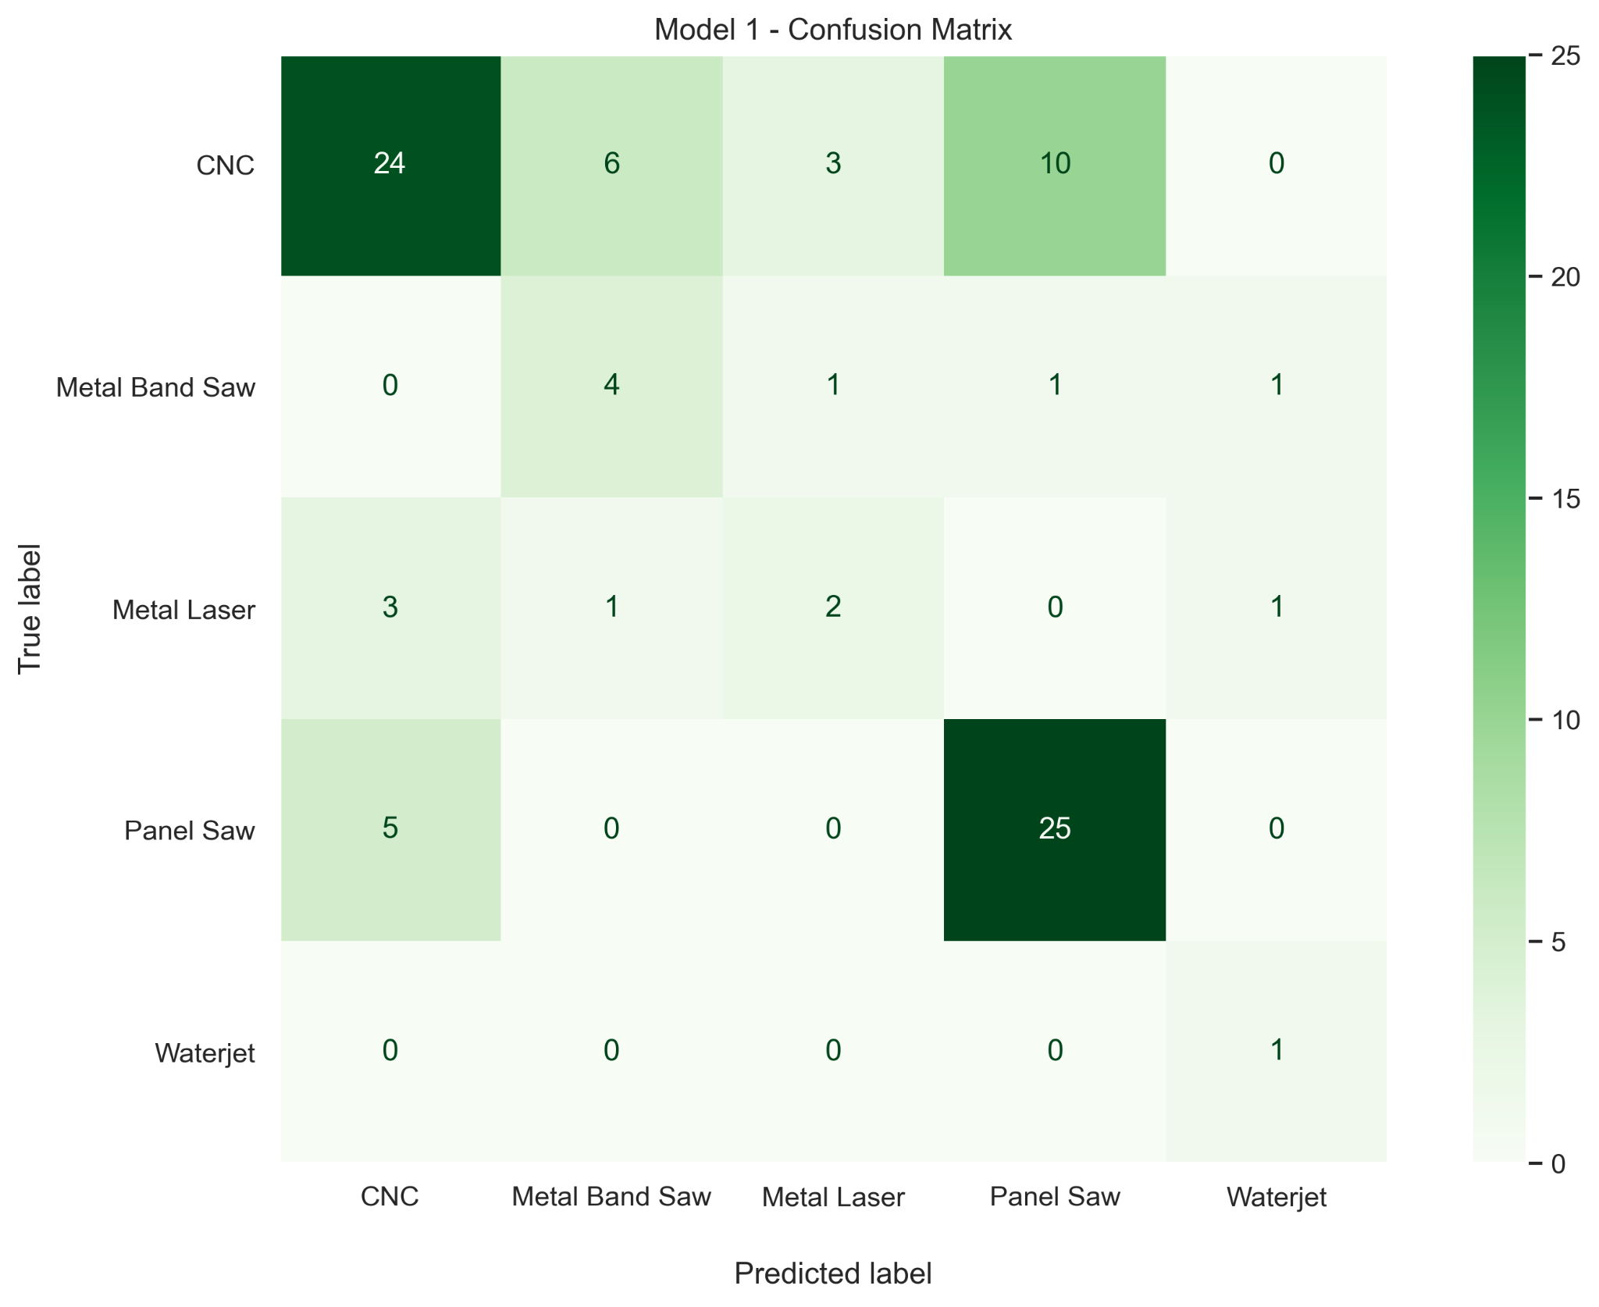
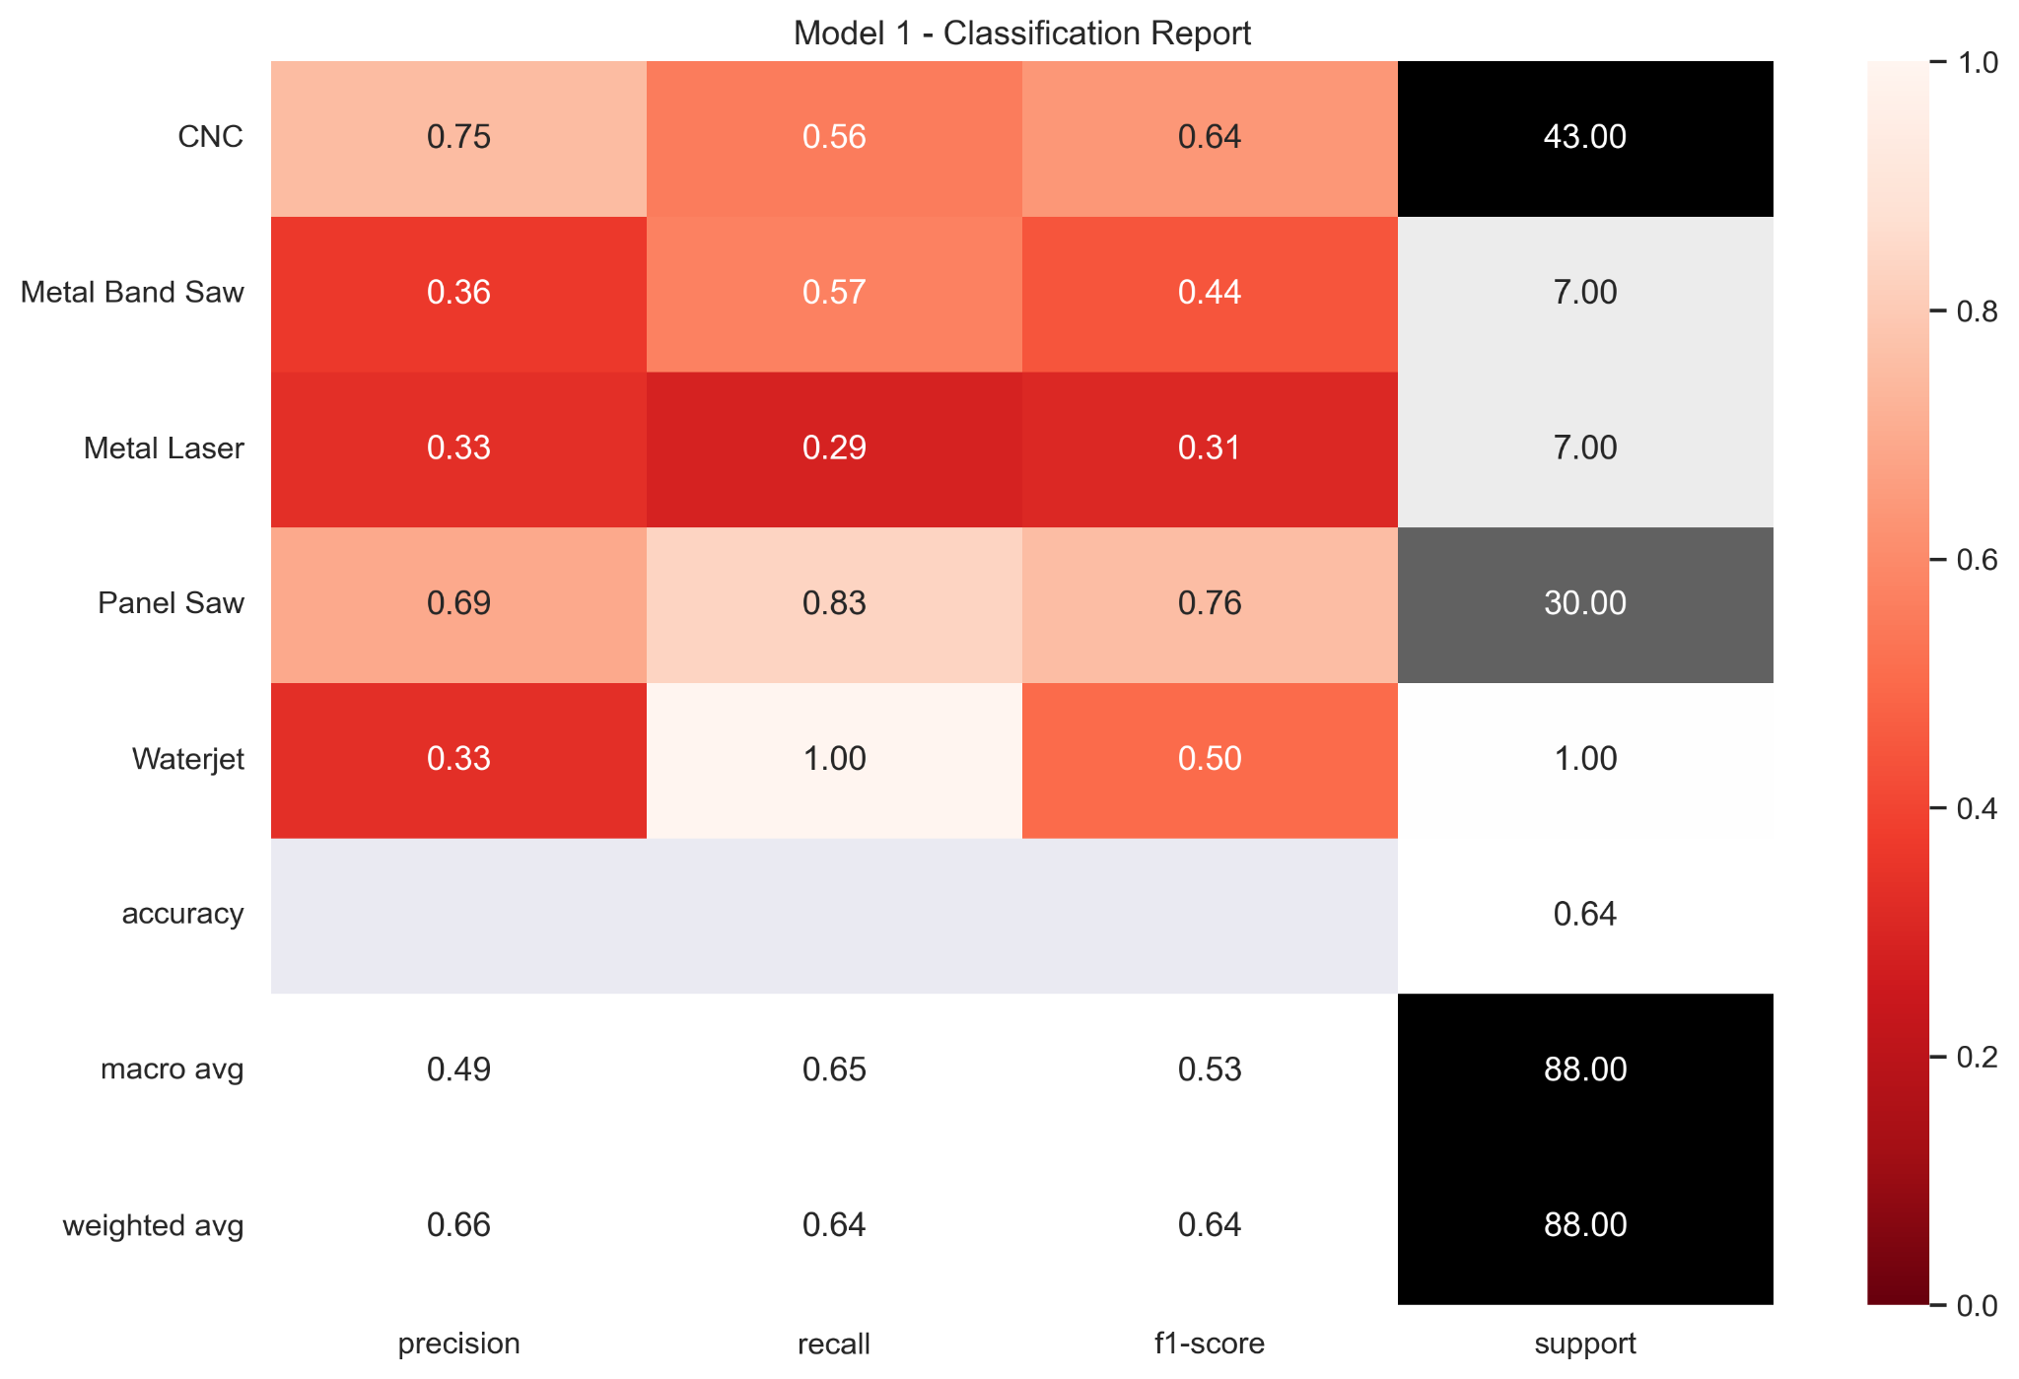
Data - Model 1
Values with data augmentation

Slide 23
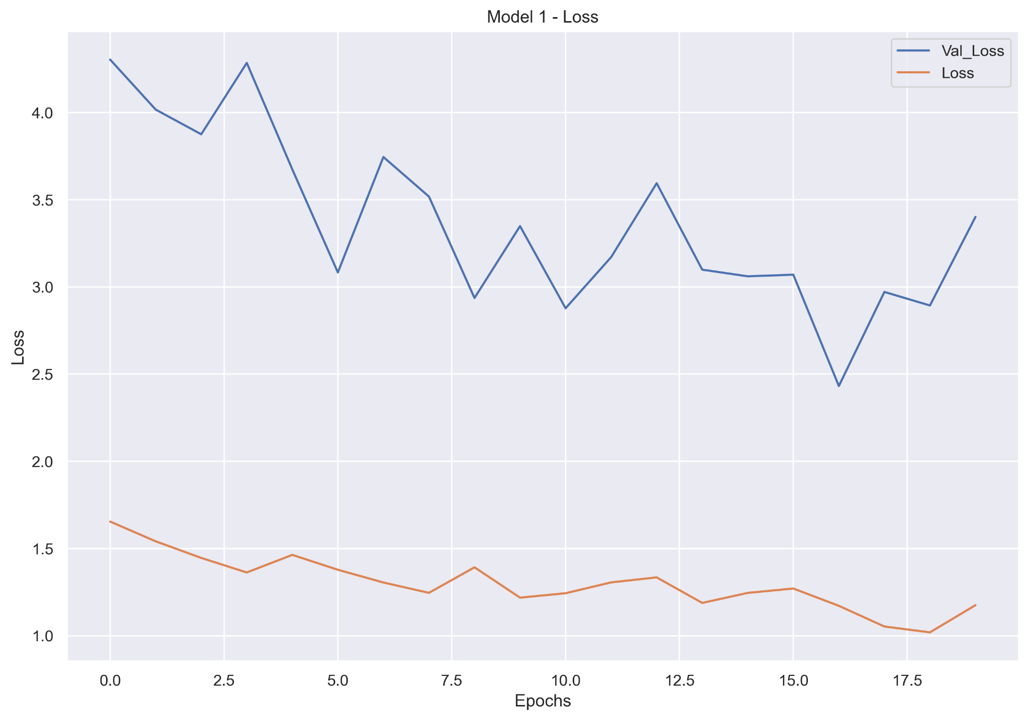
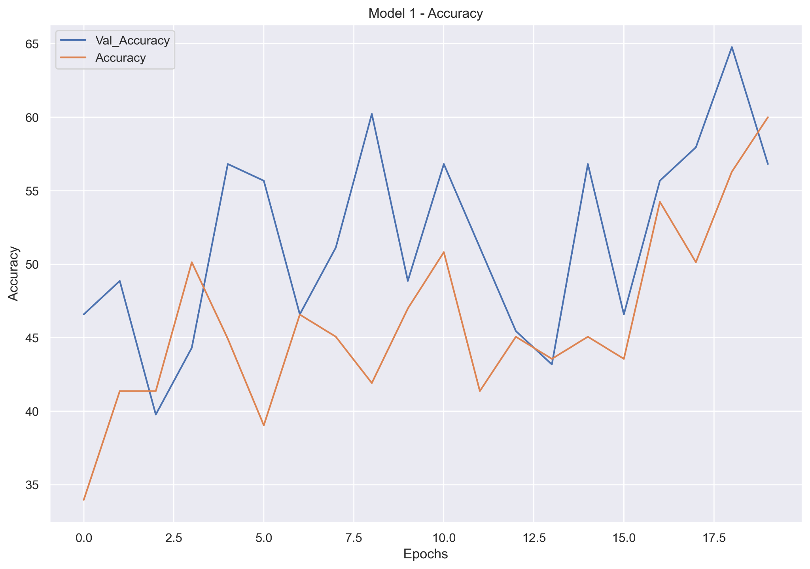
Data - Model 1
Loss improving over time
Accuracy improving over time

Slide 24
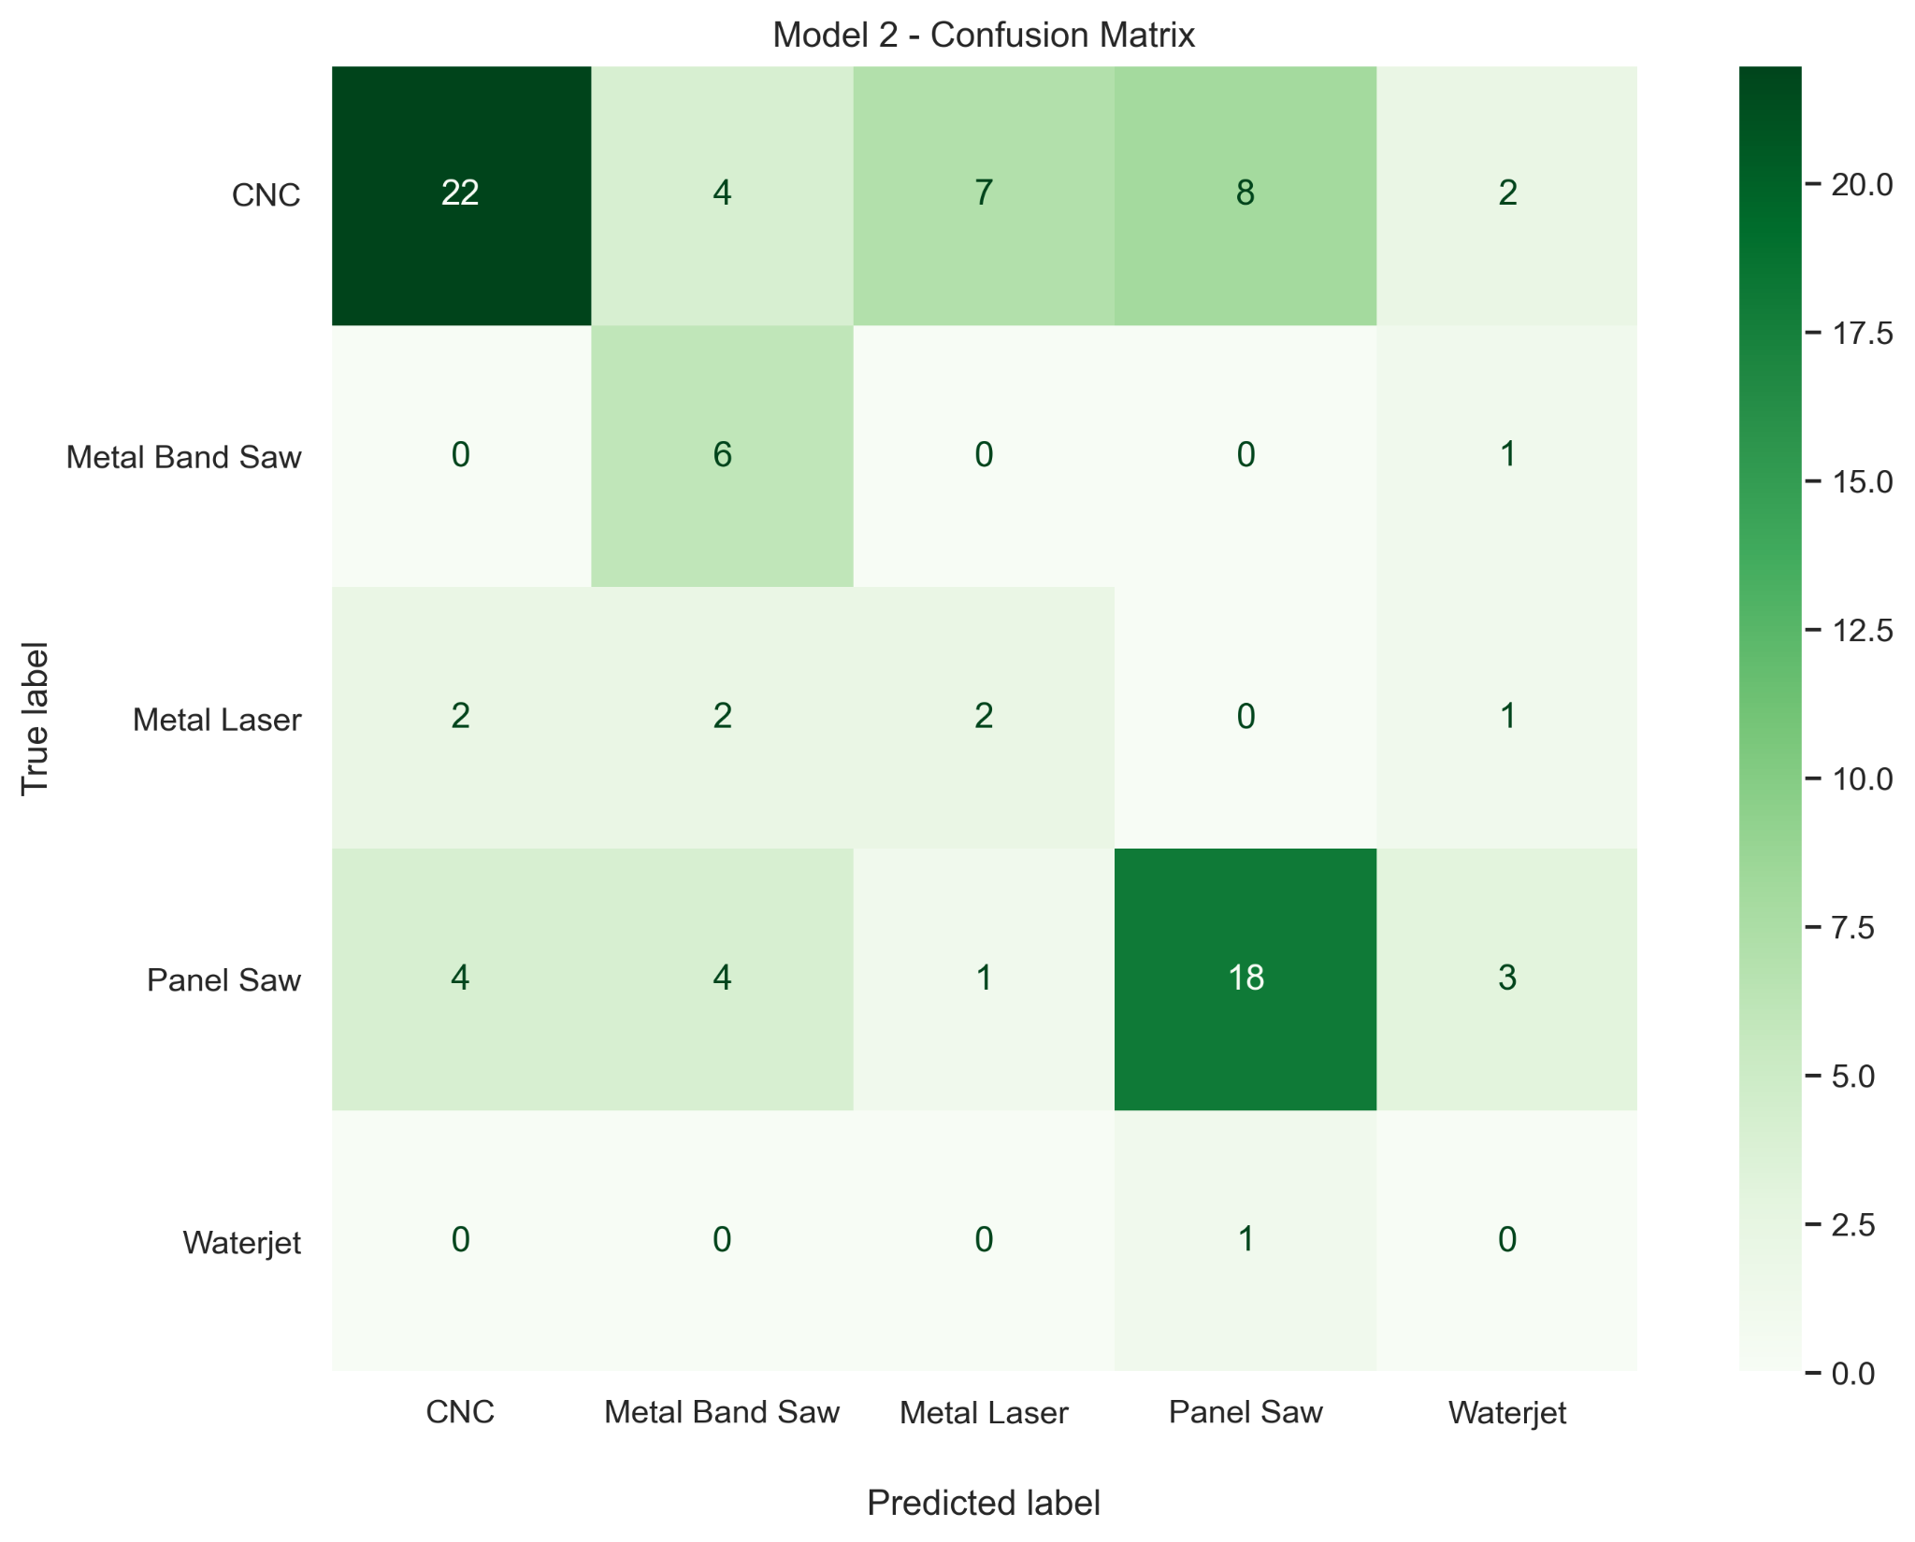
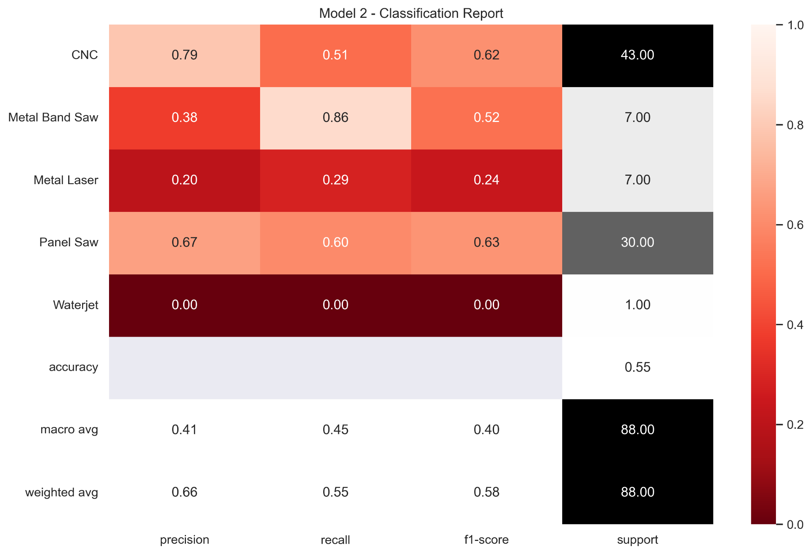
Data - Model 2
Values with data augmentation
Expand Channels for neural network

Slide 25
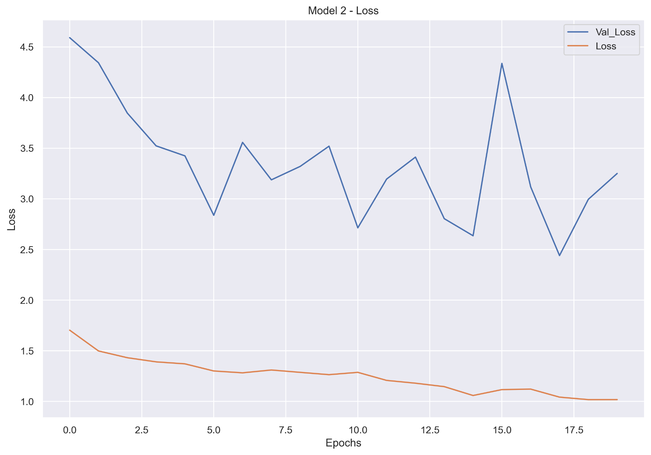
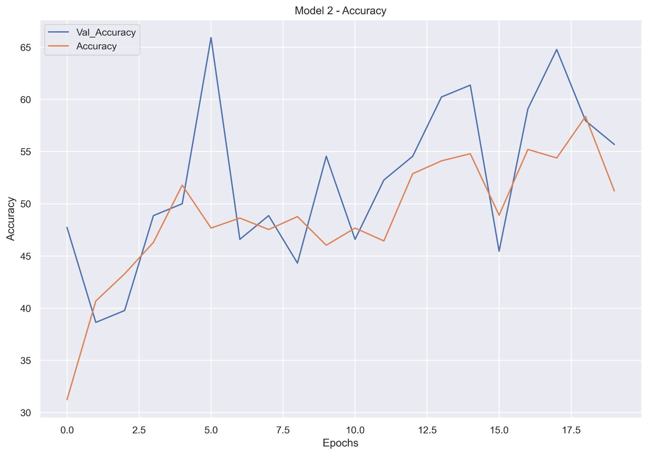
Data - Model 2
Loss slowly improving over time
Accuracy improving over time

Slide 26
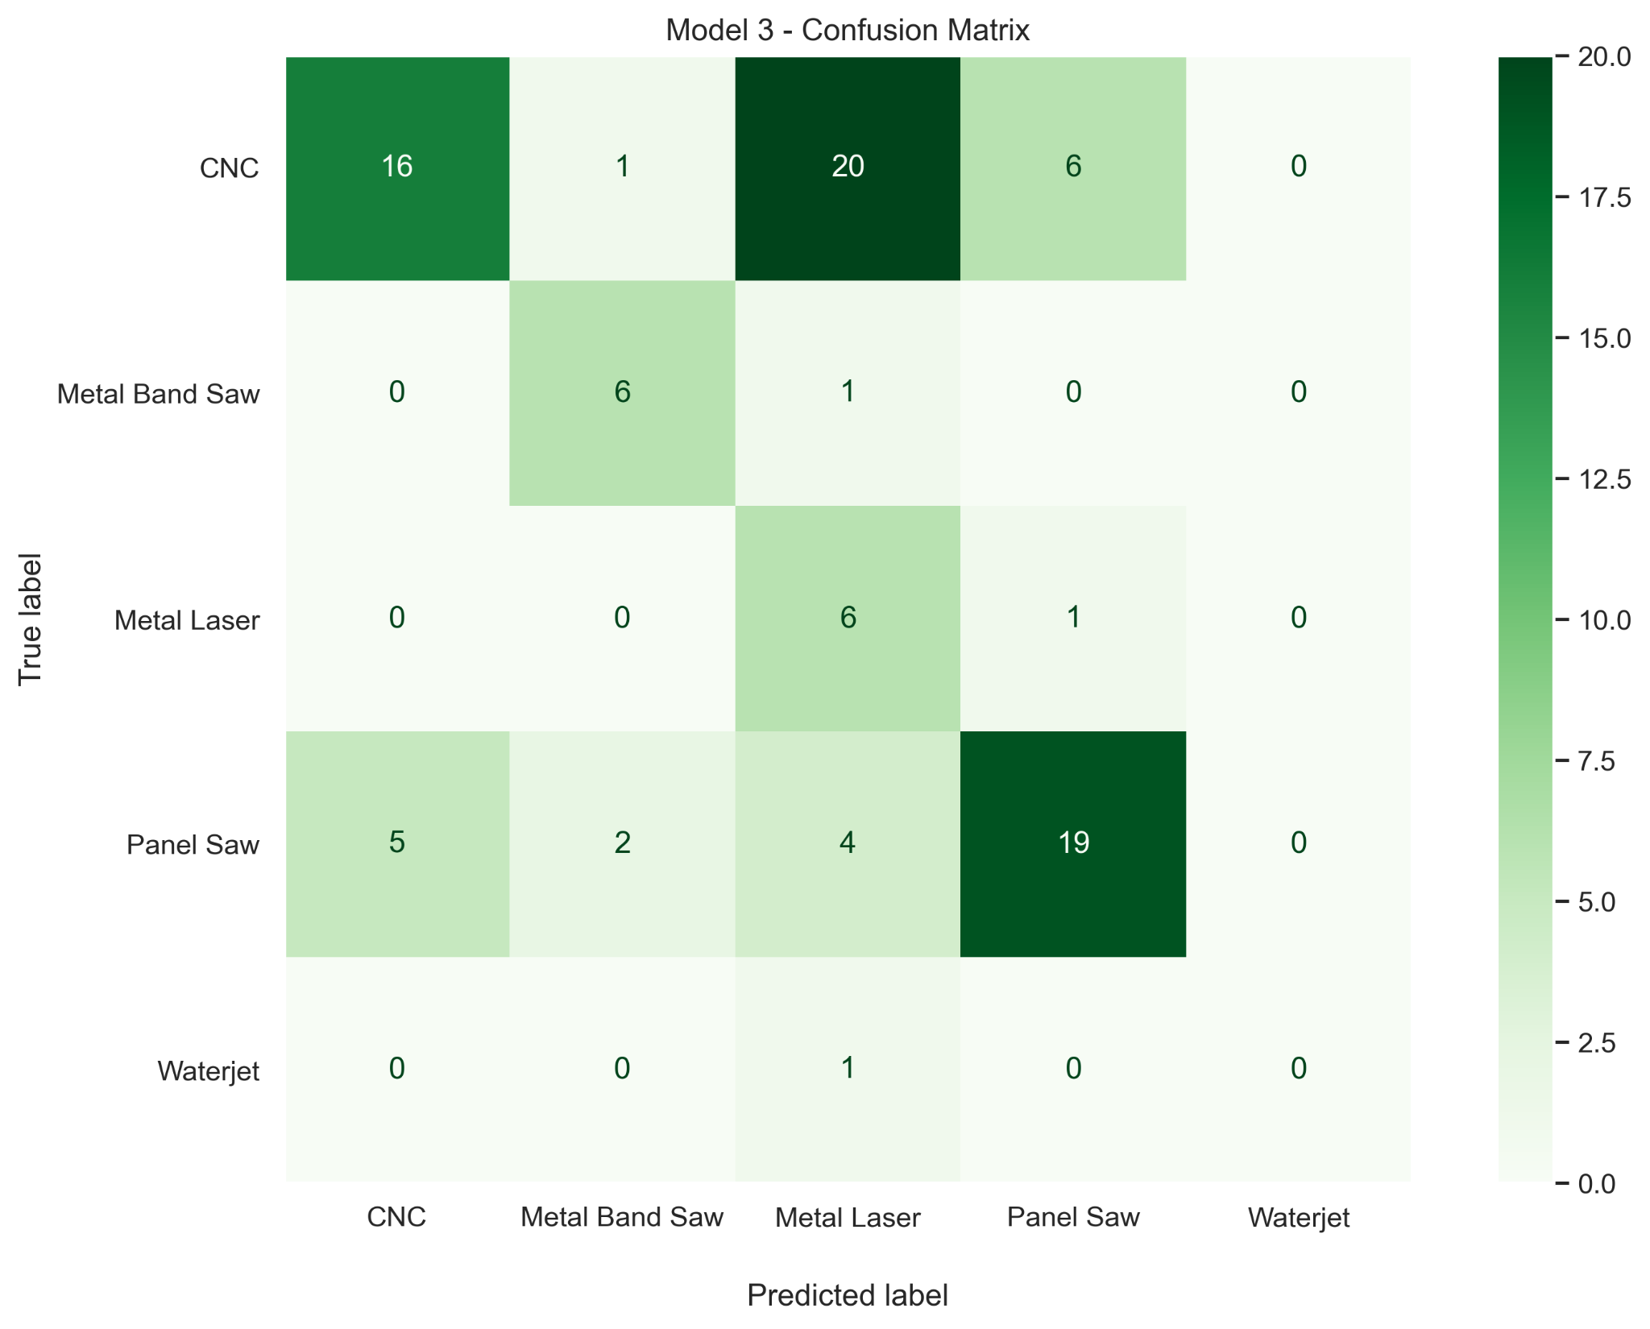
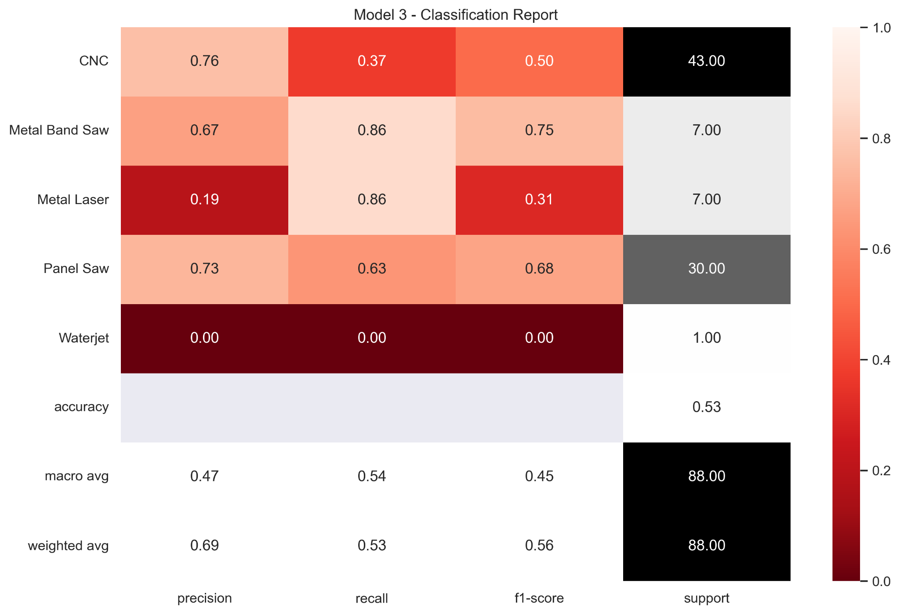
Data - Model 3
Values with data augmentation
Lower batch size and different optimizer

Slide 27
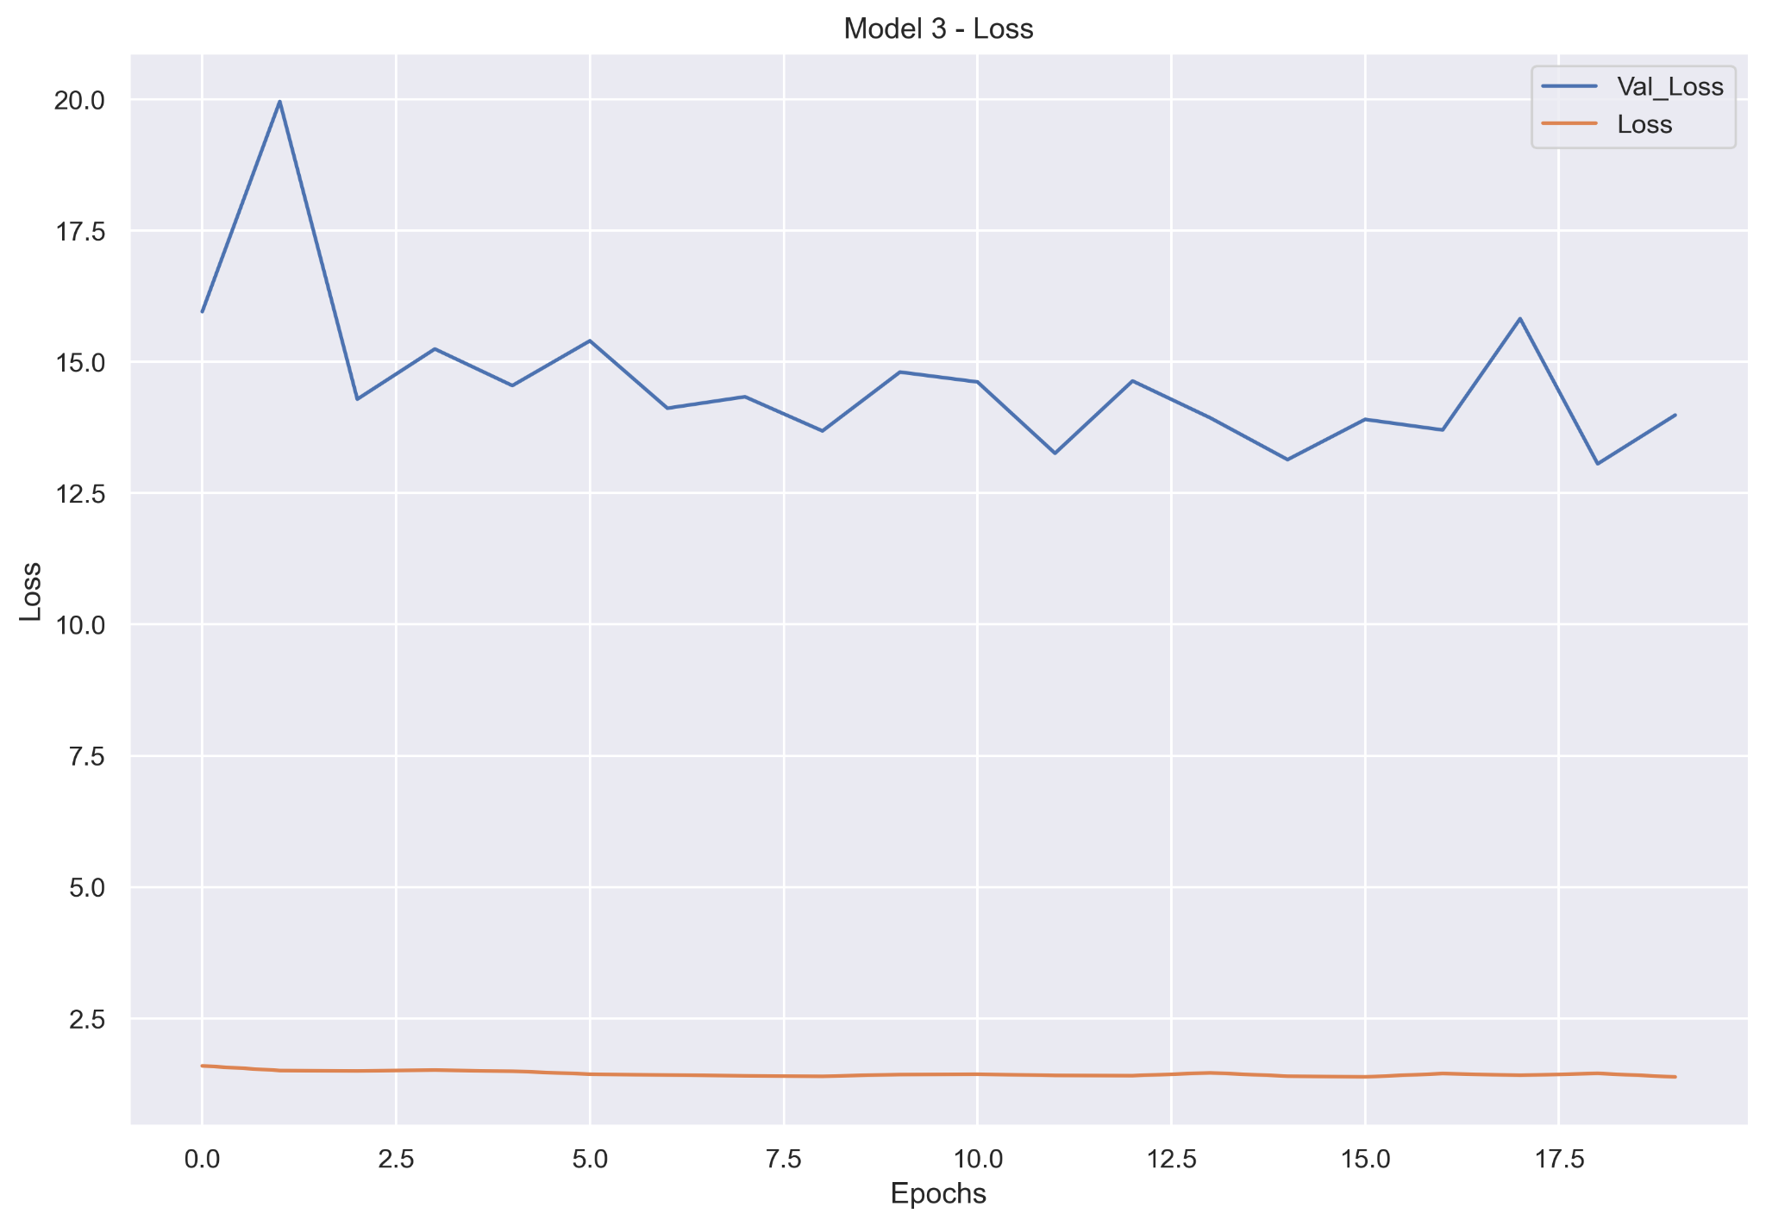
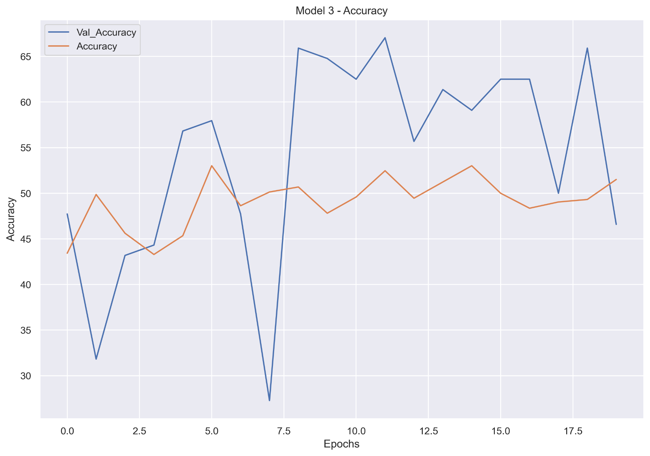
Data - Model 3
Loss stagnating
Accuracy erractic

Slide 28
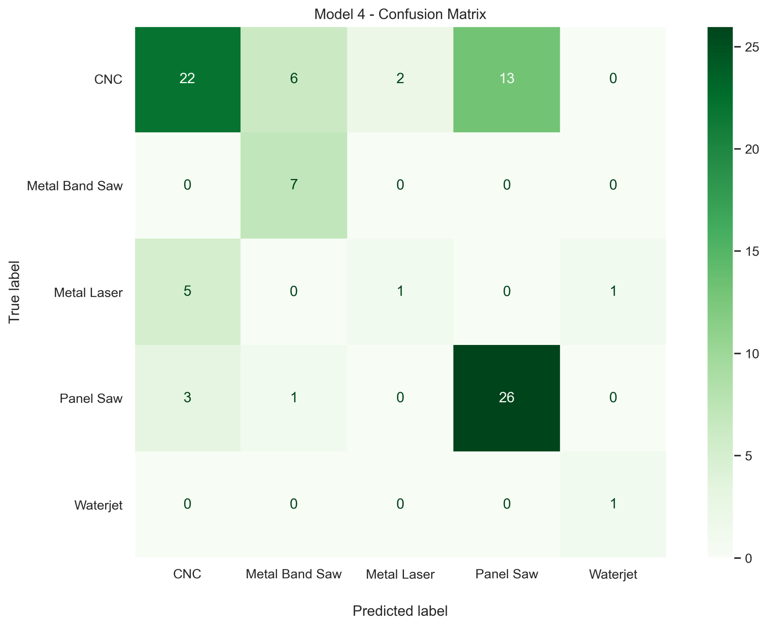
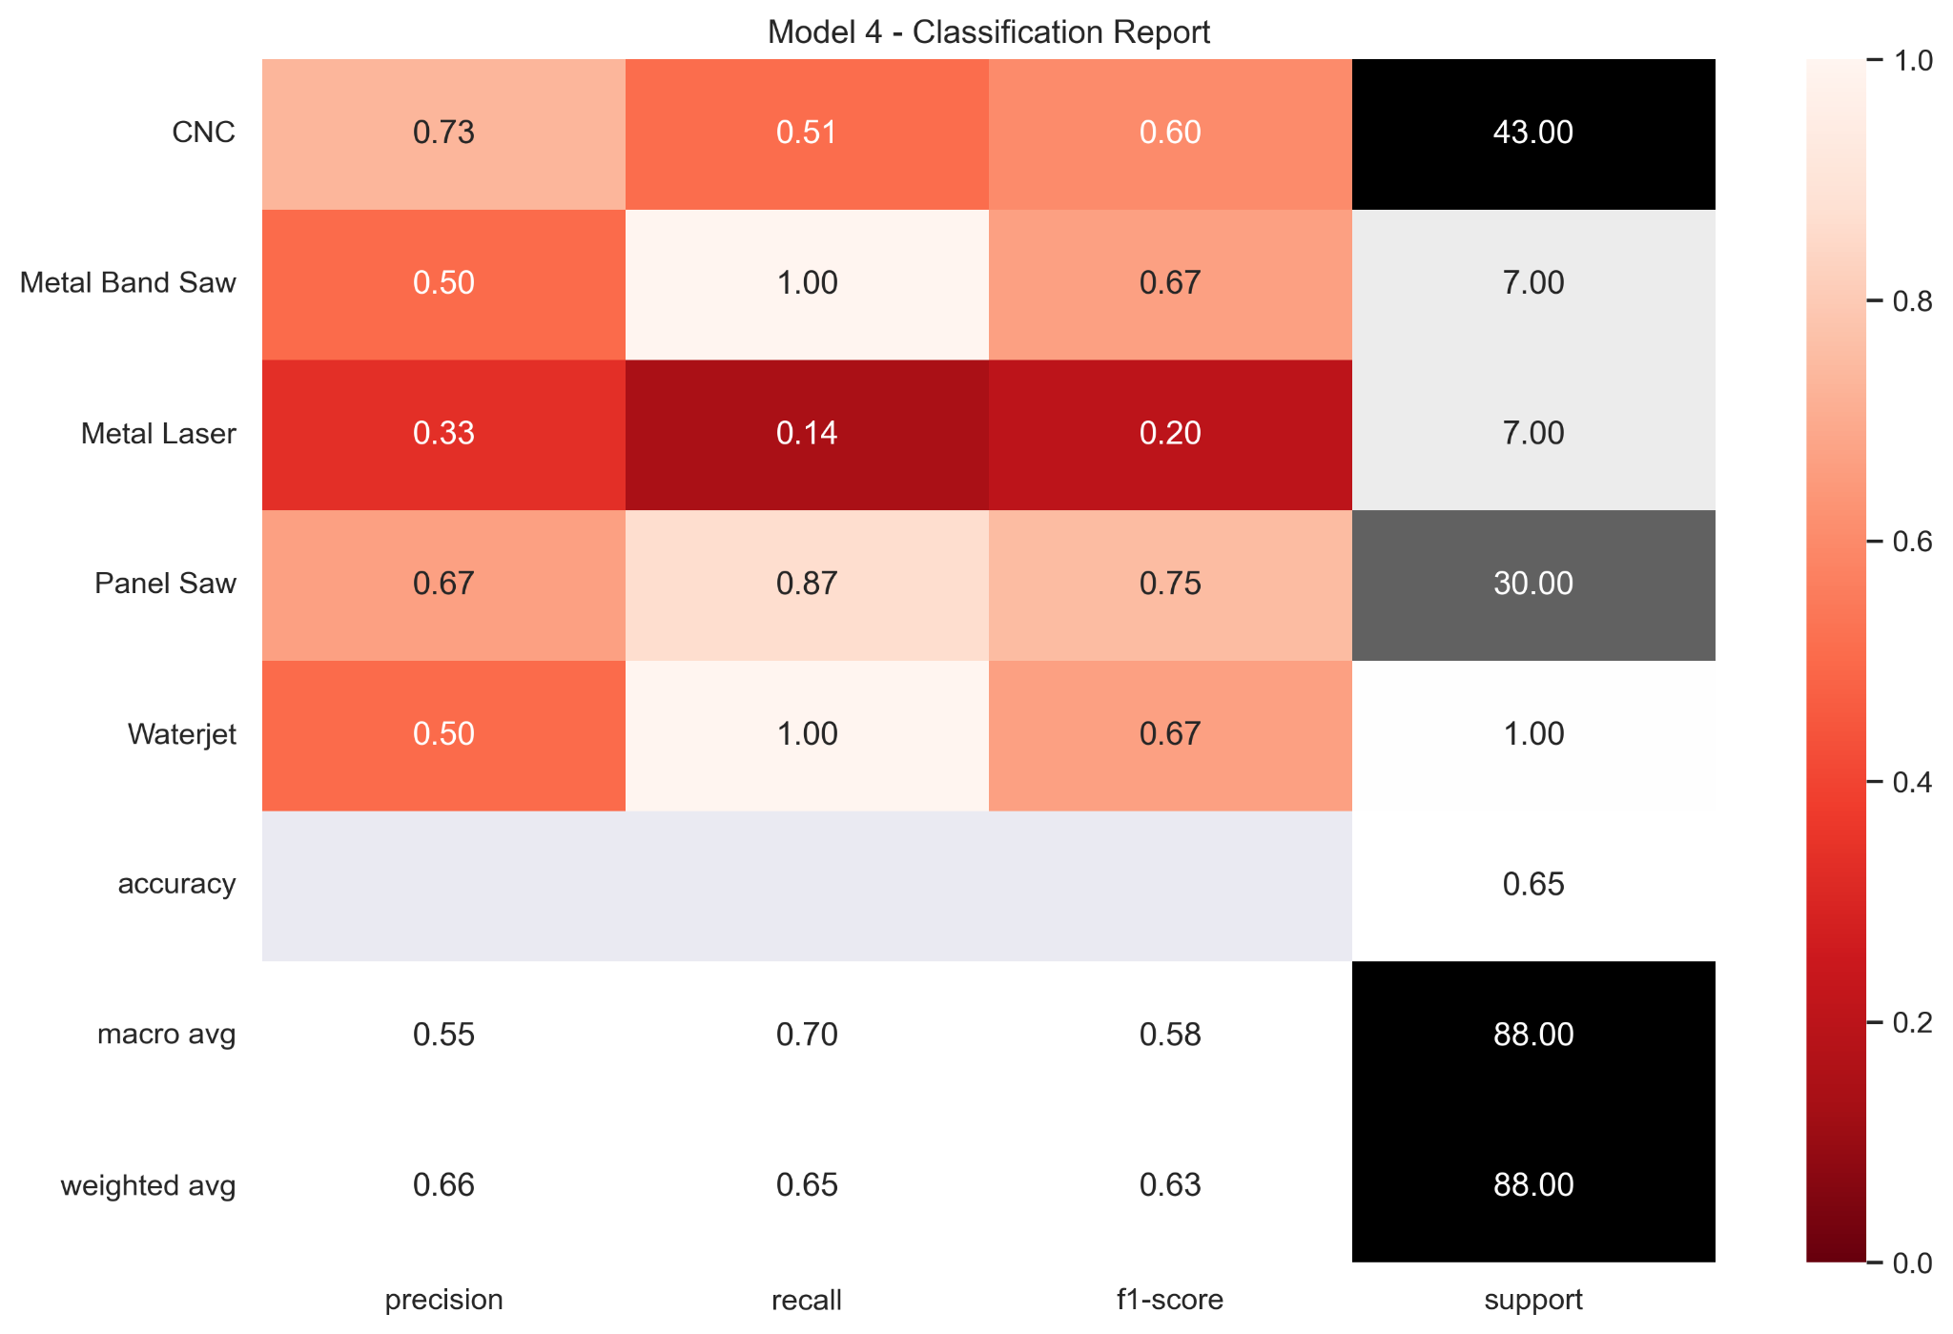
Data - Model 4
Values with data augmentation
Longer training improving on model 2

Slide 29
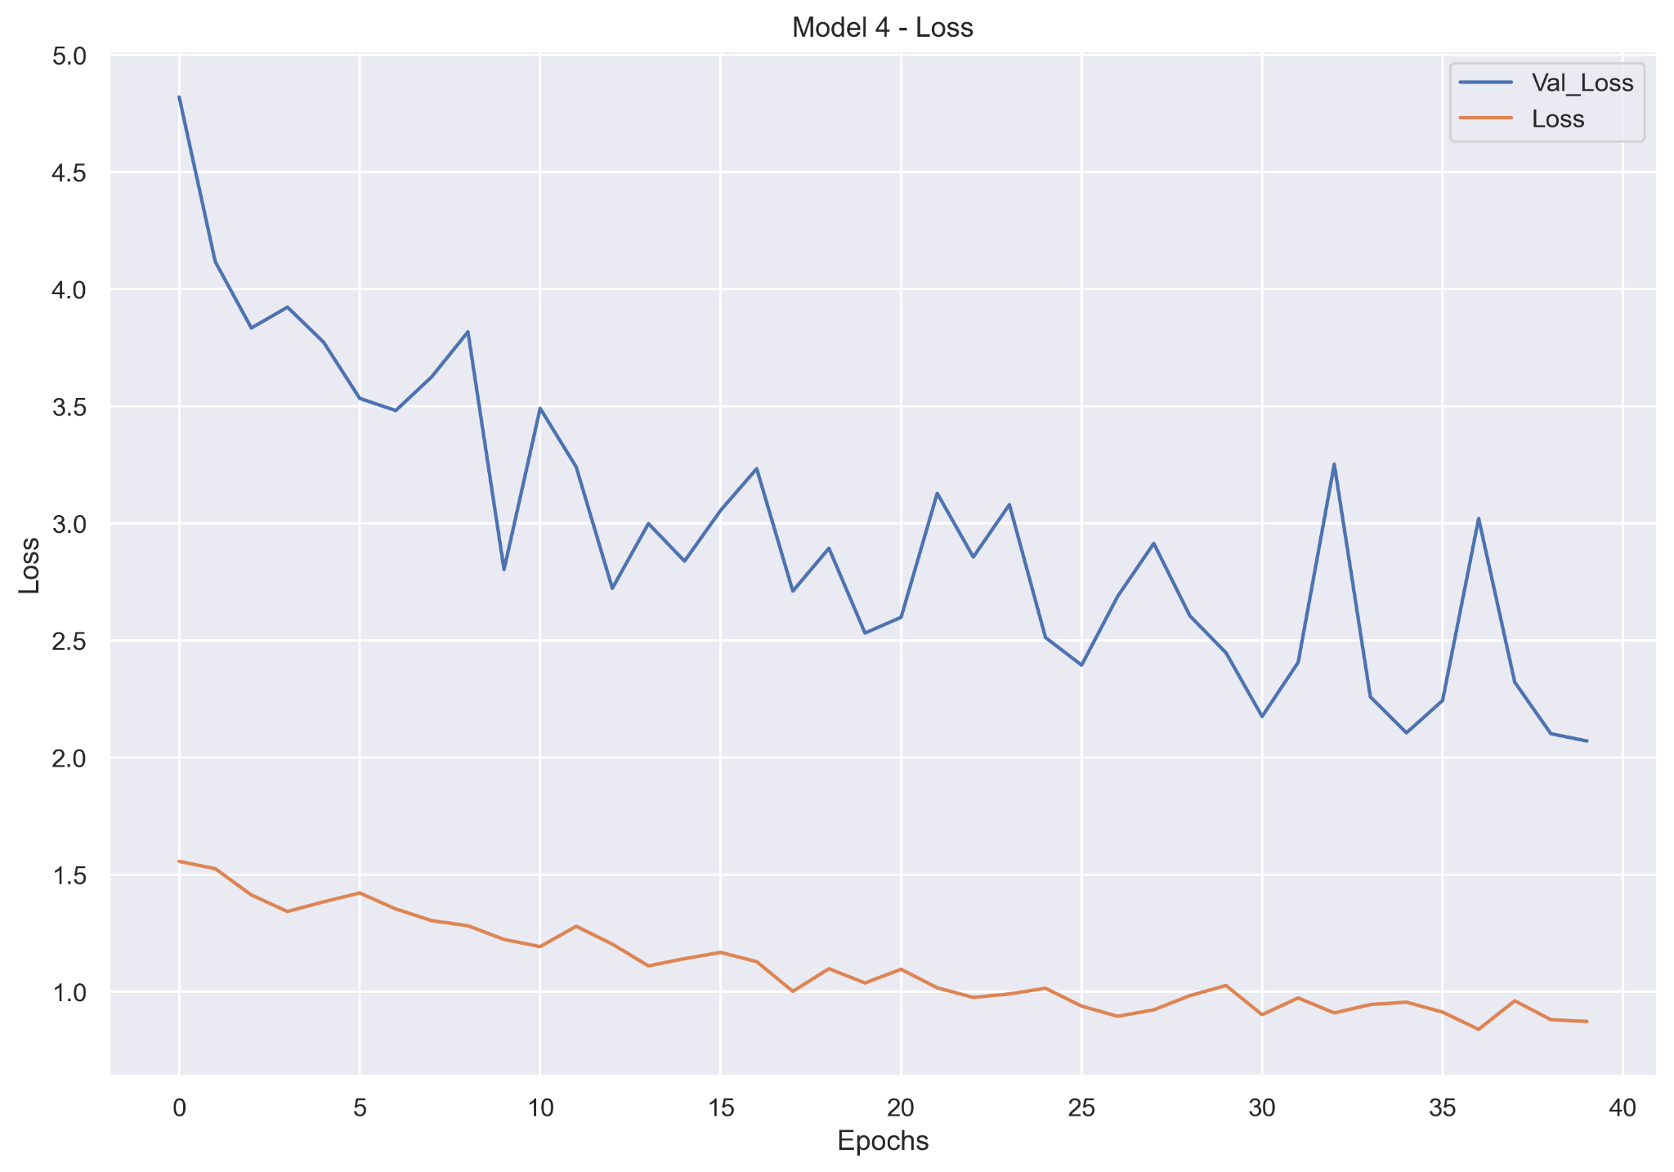
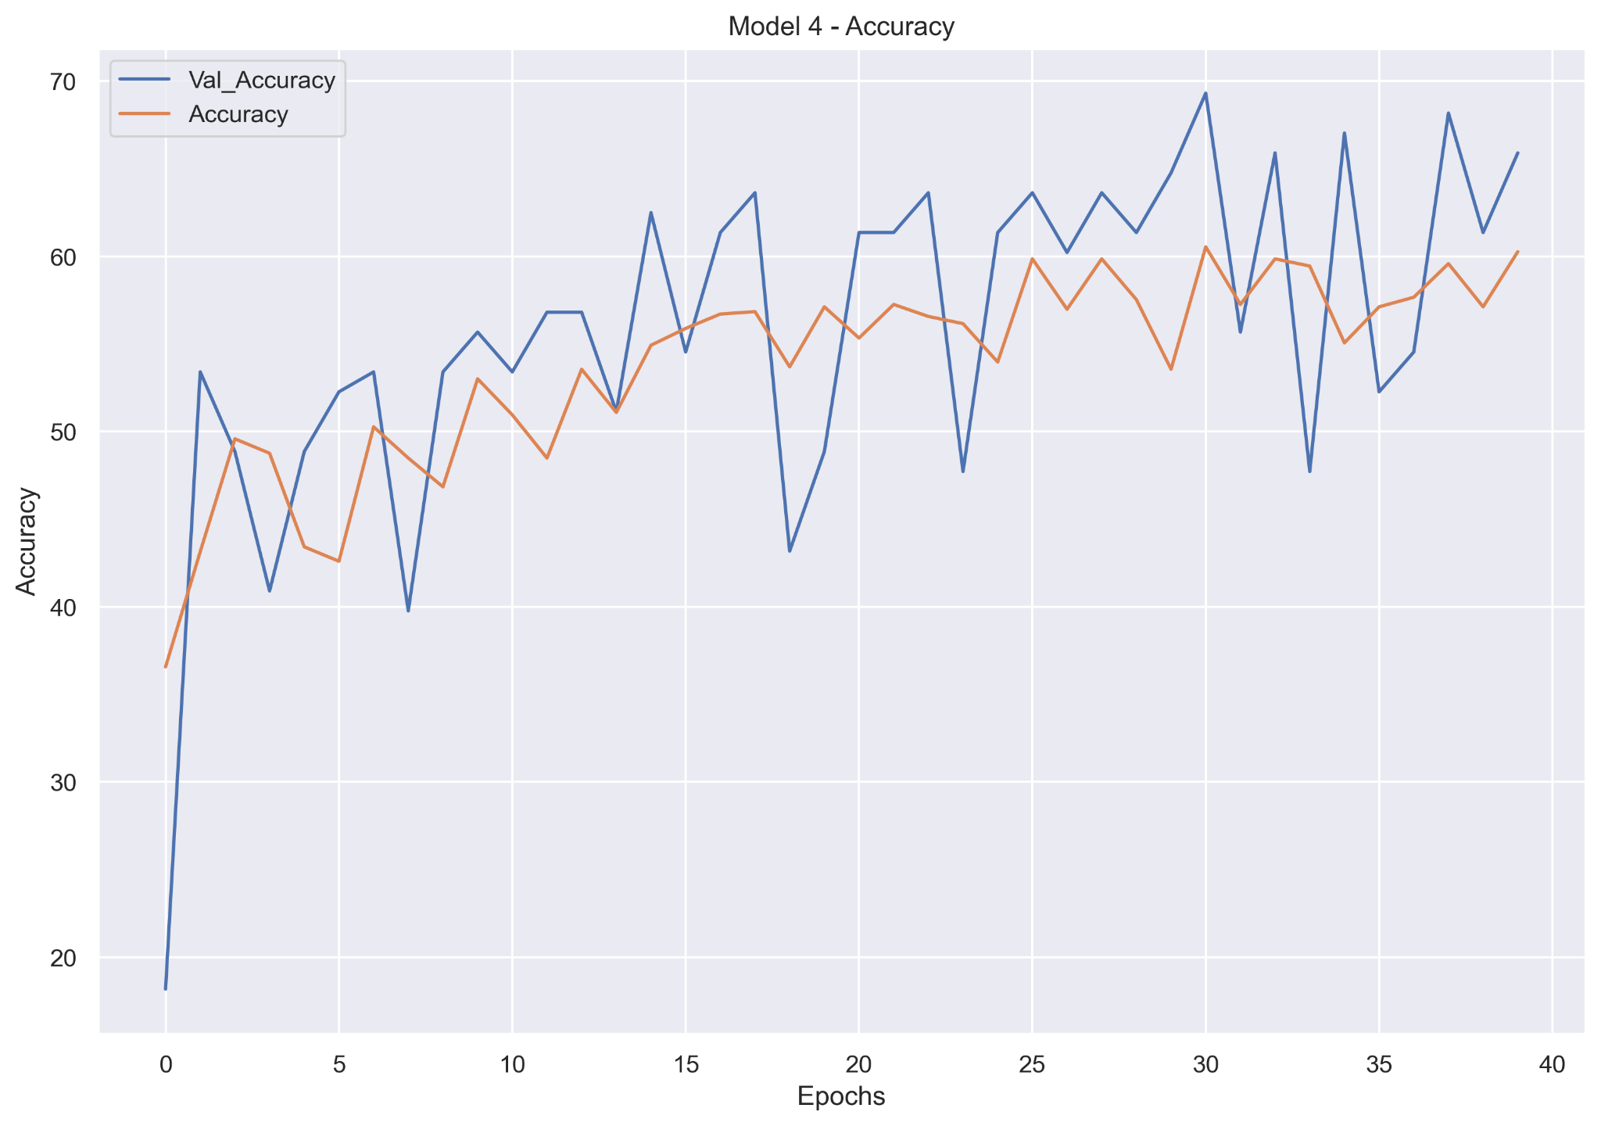
Data - Model 4
Loss improving over time
Accuracy improving over time

